Slide 1
Department of Psychology Messiah College
http://www.messiah.edu/departments/psychology

Slide 2
What is Psychology?
Psychology is “the study of the behavior and mental processes of humans.”
Draws students who want to work with people or who want to have a sophisticated understanding of others.

Slide 3
Why Study Psychology?
“A human being is a microcosm of the universe, ‘a rare example of God’s power, goodness, and wisdom, and contains within…enough miracles to occupy our minds’.” – John Calvin
“I praise you because I am fearfully and wonderfully made;
your works are wonderful,
I know that full well.” Psalm 139:14 (NIV)
“But Jesus did not trust Himself to them, because he knew all men and needed no one to bear witness of man; for he himself knew what was in man.” John 2: 24, 25 (RSV)

Slide 4
Distinctives of Psychology at Messiah College
Students
Faculty
Facilities
Faith Integration
Enrollment has consistently been one of the highest for all the departments at Messiah College.

Slide 5
Psychology Curriculum at Messiah College
Comparable to Psychology programs at other schools
Students will take courses that are theoretical, clinical, and experimental nature
Many courses combine academic theory with hands on experience
Students consider connections between subject matter and a Christian world view

Slide 6
Psychology at Messiah College: Degrees offered
Bachelor of Arts (B.A.) in Psychology
● with optional Clinical Concentration
Bachelor of Science (B.S.) in Psychology
B.S. in Biopsychology
Psychology Minors
● Psychology
● Pre-Counseling and Therapy (interdepartmental with HDFS)
● Community Psychology

Slide 7
Psychology at Messiah College: B.A. vs. B.S.— What’s the Difference???
a B.A. in Psychology:
Prepares students for placements in entry-level positions in the helping professions or for graduate school in many sub-fields of psychology.
a B.S. in Psychology:
● Designed for students who intend to work in a field that has a stronger emphasis on science or math or for those who wish to pursue graduate studies that lean more towards research and the sciences.

Slide 8
Psychology at Messiah College: Division of Credits for the B.A. & B.S. in Psychology

Slide 9
Psychology at Messiah College: B.S. in BIOPSYCHOLOGY
Biopsychology is the scientific study of the biology of behavior and mental processes (such as learning, memory, perception, attention, motivation, emotion, and cognition).
Our B.S. in Biopsychology is a collaborative effort with the Department of Biological Sciences.
Prepares students who are interested in fields such as:
● Medicine ● Psychopharmacology
● Psychiatry ● Neuropsychology
● Cognitive neuroscience ● Behavioral genetics
● Occupational therapy ● Comparative Psychology

Slide 10
Psychology at Messiah College: Division of Credits for the B.S. in Biopsychology

Slide 11
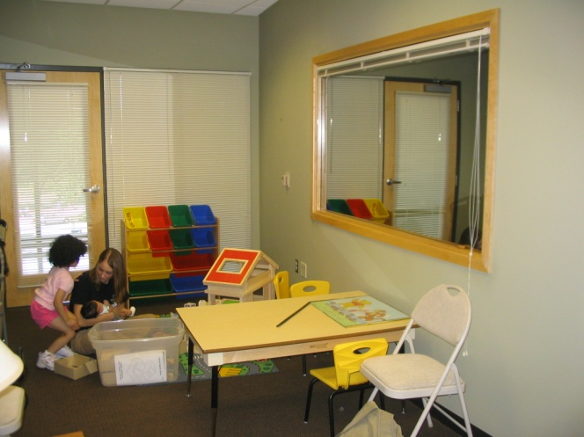
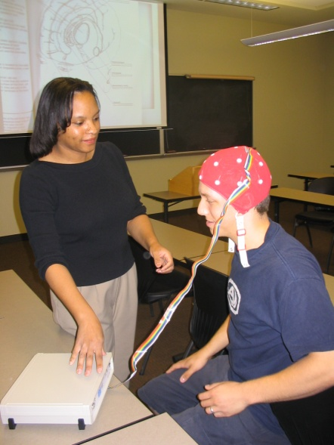
Psychology at Messiah College: State-of-the-Art Equipment
An academic building that includes:
Interview rooms with recording capability
Group observation/counseling area with
recording capability
Physiological recording equipment for Biopsychology:
Biopac Student Lab Equipment
EEG (electroencephalogram - brain waves)
EOG (electrooculogram - eye movement)
EMG (electromyogram - muscle contraction)
EKG (electrocardiogram-- heart)
Reaction time measurement.

Slide 12
Psychology at Messiah College: Opportunities in Psychology
Join Active Minds, which educates students on mental illness by reaching out through service to the local community
Become a member of Psi Chi, the national honor society for Psychology
Connect faith and academics through the completion of service learning projects related to psychology
Research, write, and present with faculty members
Complete a Senior Major Honors Project
Gain additional experience through an internship or practicum related to Psychology

Slide 13
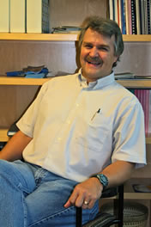
Psychology at Messiah College: The Faculty
Research & Professional Interests:
Fathering & Divorce
Cross-Cultural Studies
Technology & Its Psychological Effects
Communication technology and European Youth
Frequently Taught Courses:
Opportunities in Psychology
Cognition
Experimental Psychology
Cross-cultural Psychology
Statistical Methods in Psychology
John Bechtold, Chair
Ph.D. Kansas State
1988

Slide 14
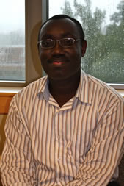
Psychology at Messiah College: The Faculty
Henry A. Danso
Ph.D. University of Western Ontario
2009
Research & Professional Interests:
Immigration Attitudes
Intelligence Test Performance
Reconciliation
Frequently Taught Courses:
Social Psychology
Lifespan Development
Topics: Research

Slide 15
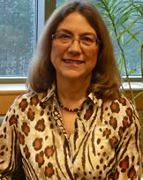
Psychology at Messiah College: The Faculty
Research & Professional Interests:
Integration of Psych & Theology
Christian Higher Education
Faculty Development in Classroom
Frequently Taught Courses:
Psychology Seminar
Women and Men in American Society
Rhonda Jacobsen
Ed.D. Temple University
1984

Slide 16
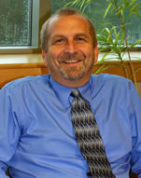
Psychology at Messiah College: The Faculty
Research & Professional Interests:
Impact of Technology on Families
Impact of Work on Adolescent Development
Body Image and Sanctification of the Body
Frequently Taught Courses:
Counseling Theories
Abnormal Psychology
History and Systems of Psychology
Adolescent Development
Charles D. Jantzi
Psy.D. Wright State
2004

Slide 17
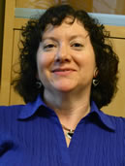
Psychology at Messiah College The Faculty
Research & Professional Interests:
Body Image and Sanctification of the Body
Forgiveness
Posttraumatic Stress Disorder
Frequently Taught Courses:
Counseling Techniques
Psychological Testing
Abnormal Psychology
Group Dynamics
Valerie A. Lemmon
Psy.D. Philadelphia College of Osteopathic Medicine
2007

Slide 18
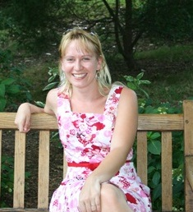
Psychology at Messiah College: The Faculty
Research & Professional Interests:
Posttraumatic Stress Disorder
Stress & Health
Addiction
Frequently Taught Courses:
Biological Basis of Behavior
Drug & Alcohol Addiction
Stress & Health
Sensation & Perception
Jennifer Thomson
Ph.D. University of North Carolina
2012

Slide 19
Psychology at Messiah College Post-Graduation Assessment
Year | Professional Employment | Advanced Degree | Other *
2009 - Psychology | 26% | 61% | 13%
2008 - Psychology | 52% | 43% | 5%
2007- Psychology | 36% | 55% | 9%
2006- Psychology | 60% | 29% | 11%
2005- Psychology | 40% | 37% | 23%
From the program’s start to date, all of our biopsychology graduates have become professionally employed in the first year after graduation.
* “Other” includes volunteer opportunities, missions work, and employment unrelated to the degree earned.

Slide 20
Psychology at Messiah College: Examples of Student Entry-Level Positions
Case Manager
Organizes and coordinates services and supports for patients, such as children with mental health problems and their families; oversees the overall medical, personal, and social service needs of the patients
Counselor
Provides professional help in coping with life issues such as emotional and relationship difficulties; helps clients and families evaluate their patterns of problem solving and develop more effective ones
Psychiatric Assistant
Assists counselors in non-therapeutic therapy. Monitors and assesses patient progress to ensure that patient treatment objectives are met. Records and reports patient information. Implements patient treatment plans and selects patient activities

Slide 21
Psychology at Messiah College: Examples of Student Entry-Level Positions
Crime Victim Advocate
Counsels victims and their families; accompanies and supports victims through the criminal justice process; provides community education, training and consultation
Social Worker
Provides social services and assistance to improve the social and psychological functioning of children and their families and to maximize the family well-being and academic functioning of children
Therapeutic Staff Support
Provides one-to-one behavioral health interventions to a child or adolescent with a serious emotional disturbance in order to prevent more restrictive services or out-of-home placement and to promote age-appropriate psychosocial growth

Slide 22
Psychology at Messiah College: Examples of Student Entry-Level Positions
Rehab Specialist
Manage the components important in the rehabilitation process of individuals with physical and mental disabilities. They help prevent fragmentation and gaps in services to people seeking to move from psychological and economic dependence to independence
Residential Counselors
In charge of group homes. The residents of these homes include emotionally disturbed, developmentally disabled, and mentally ill youth and adults. People in homes supervised by residential counselors may also have physical problems, but the problems that keep them from being self-sufficient are primarily mental or emotional
Home Care Aide
Helps elderly, disabled, and ill persons live in their own homes or in residential care facilities instead of in a health facility

Slide 23
Psychology at Messiah College: Graduate Schools of Recent Grads
Messiah College Masters of Arts in Counseling
American University
Brandeis University
Biola University, Rosemead School of Psychology
Evangelical Theological Seminary
MCP Hahneman University
Indiana University of Pennsylvania
Jerusalem University College
Millersville University
New York University
Regent University
Shippensburg University
Wheaton College Graduate School

Slide 24
Psychology at Messiah College: Graduate Schools of Recent Grads
State University of NY at Albany and Brockport
Temple University
Thomas Jefferson University
Towson University
Mount St. Mary’s College
University of Central Florida
University of Connecticut
University of Maryland
University of Wisconsin
University of Texas
St. Joseph’s University
Virginia Polytechnic Institute and State University
William and Mary School of Law

Slide 25
Department of Psychology Messiah College
http://www.messiah.edu/departments/psychology

