Slide 1

Student Research Opportunities
School of Science, Engineering and Health
Roseann K. Sachs, Ph.D.
Department of Chemistry and Biochemistry

Slide 2
Six Academic Departments
within SEH
Biological Sciences
Chemistry and Biochemistry
Computing, Mathematics and Physics
Health, Nutrition and Exercise Science
Engineering
Nursing
Faculty of these departments routinely engage in research projects/programs that are intended to involve student collaborators.

Slide 3
Research in the Natural and Physical Sciences at Messiah University
Experience how science is done.
Develop critical thinking, planning, reflection, technical skills and patience.
Integrate material across disciplines to solve problems
Discern potential career paths
Student-faculty collaborations provide material for strong letters of recommendation (graduate school, medical school, or employment)

Slide 4
Research as Part of the Curriculum at Messiah University
Academic year credit for individual projects
College honors projects
Paid, on campus opportunities in the summer
Advising and letters of recommendation for students seeking to pursue research at major research universities over the summer

Slide 5
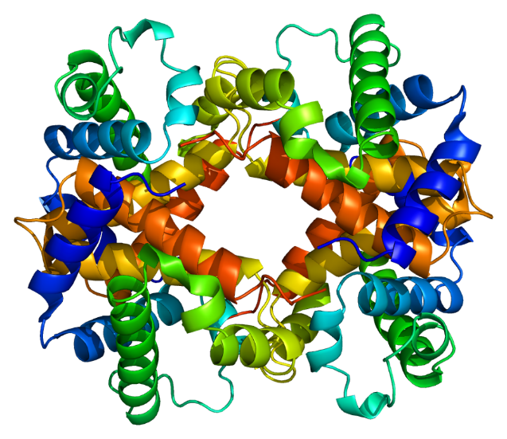
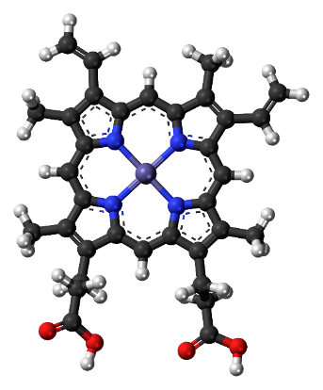
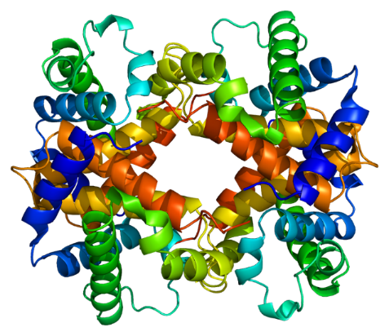
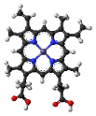
Designed Heme c Binding Proteins
+
=
Catalysis
O₂ Transport
Hydrogen Production
Dr. Jesse Kleingardner, Biochemistry

Slide 6
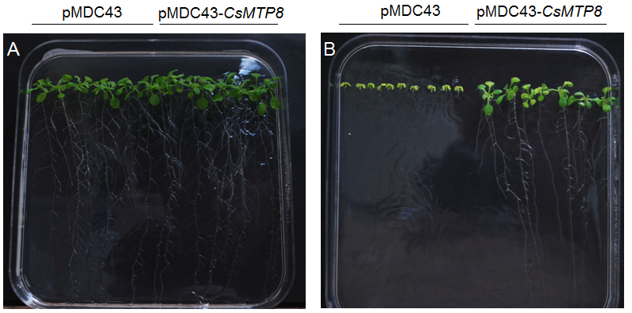
Designing plants to remediate heavy metals from soil
Dr. Michael Shin, Biology

Slide 7
Ecocatalysis Using Heavy Metals Recovered by Phytoremediation
Dr. Roseann K. Sachs, Chemistry

Slide 8
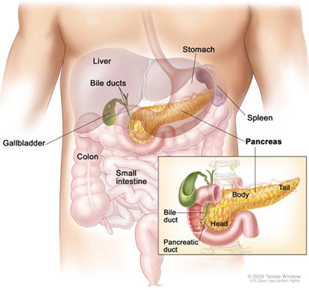

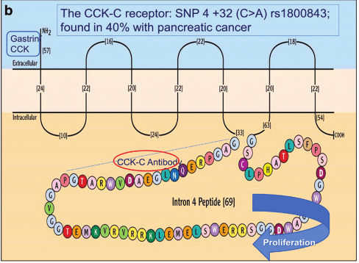
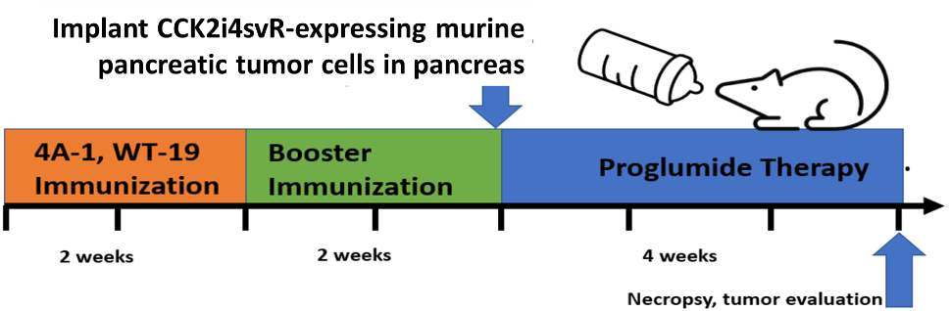
T cells: “Tumor Cell Vaccine” to fight pancreatic cancer
Control or engineered SV40 T antigen protein genes
WT-19
4A-1
Inserted target epitope
Weakly immunogenic epitope target from pancreatic cancer engineered into highly immunogenic oncoprotein (SV40 T ag)
Tumors absent or very small in vaccine group!
Dr. Larry Mylin, Biology

Slide 9
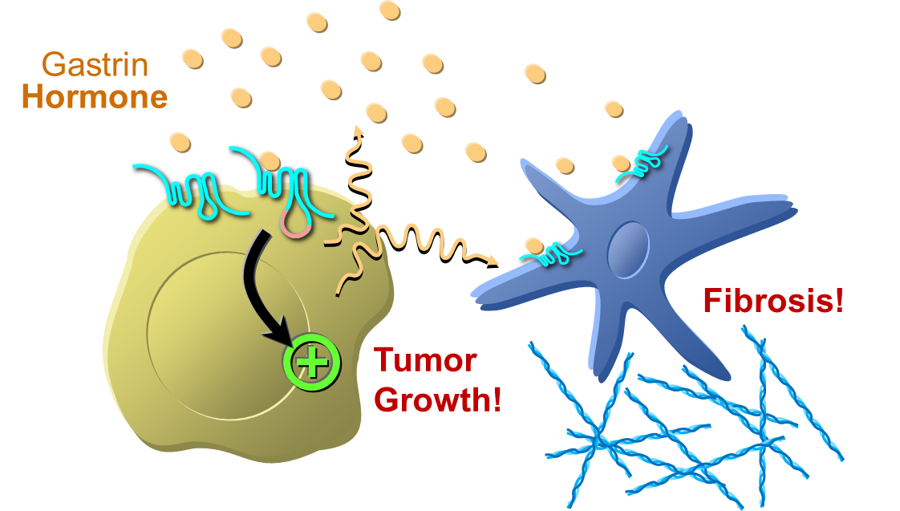
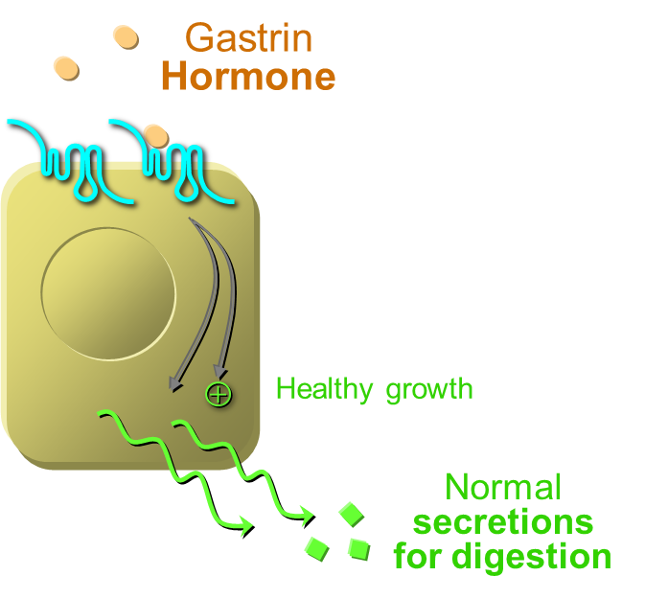
How hormone signaling drives
Pancreatic Cancer Aggressiveness
Pancreatic Cancer
Normal Pancreas
Fibrous “scar tissue” collapses 75% of the blood vessels & blocks chemotherapy!
Dr. John Harms, Biology

Slide 10
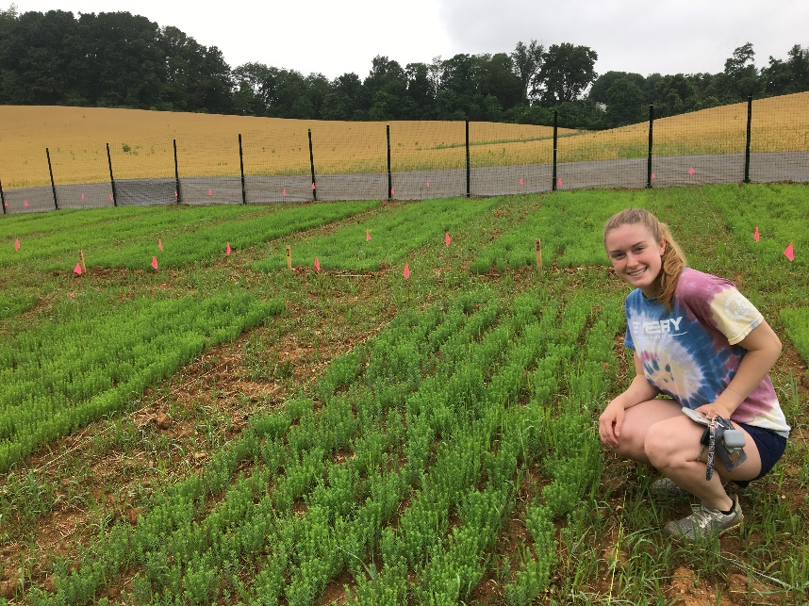
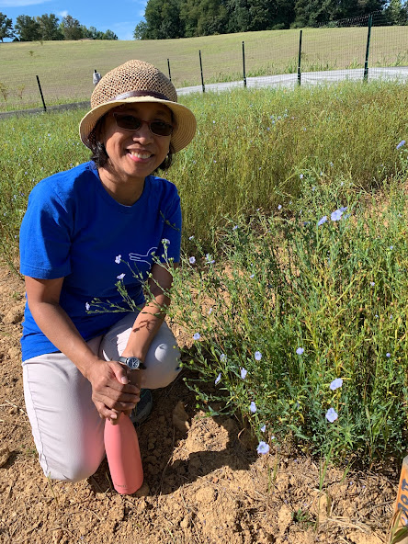
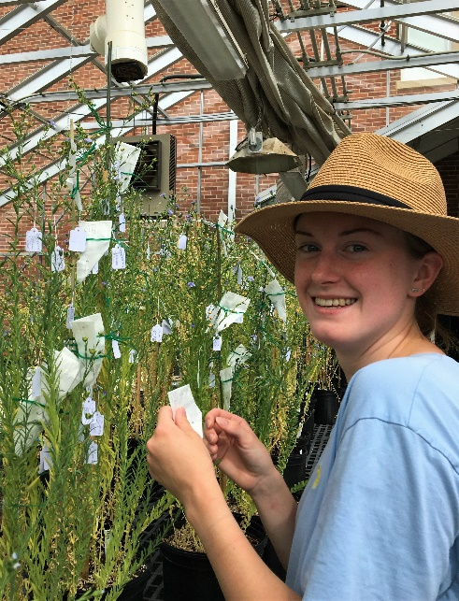



Flax in Pennsylvania
Flax as a functional food to prevent chronic diseases
Flax variety trials in the field
Flax hybrids in the greenhouse
Dr. Janet Matanguihan

Slide 11
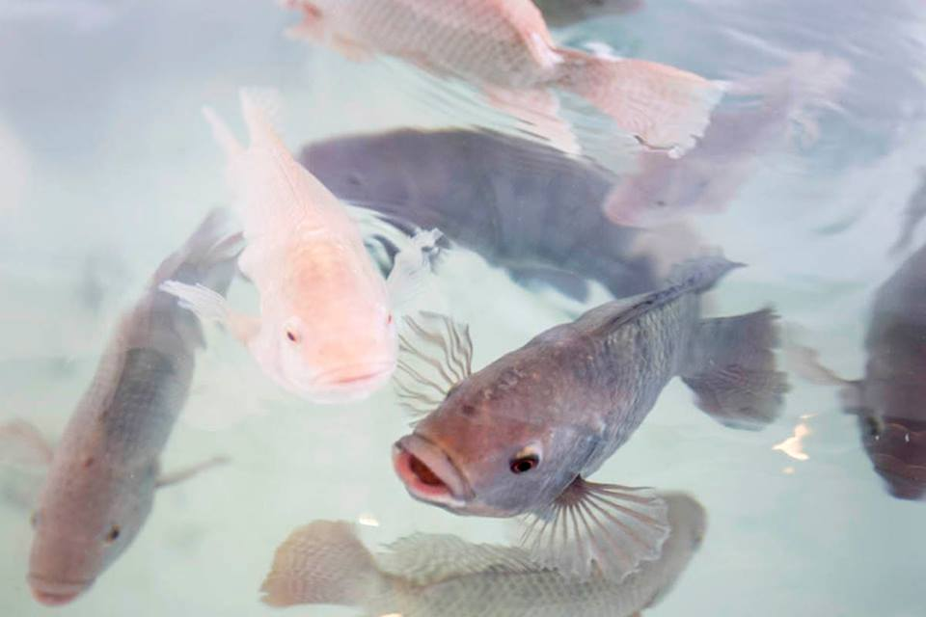
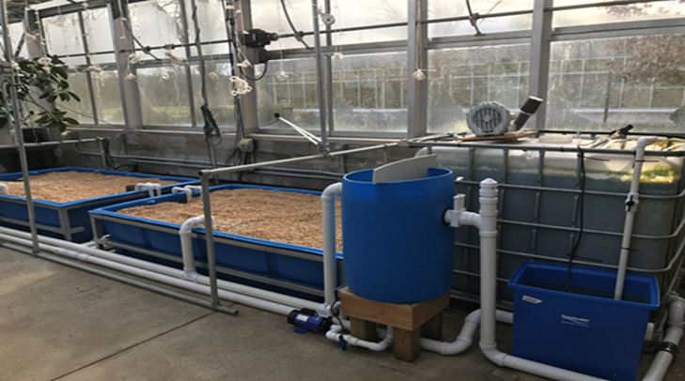
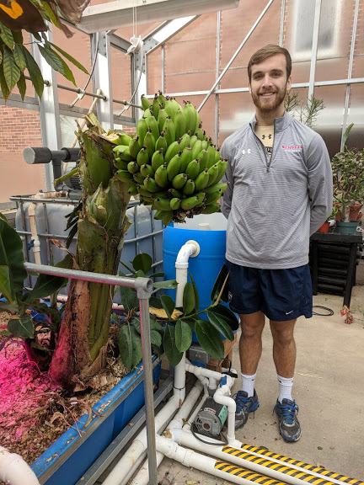
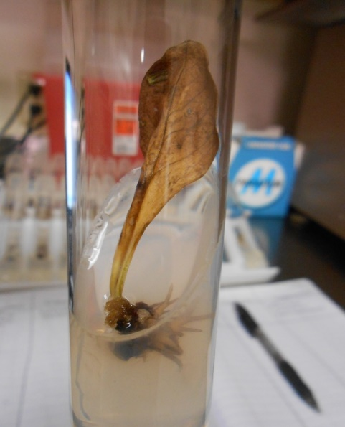
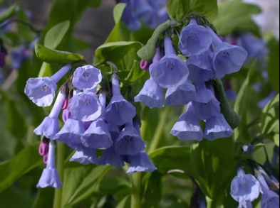

Aquaponics
Optimization of aerobic fish waste digester for nitrate; fulvic acids
Optimal fruit set
Wide variety of plants
Native Plant Propagation
Dr. David Foster, Biology

Slide 12
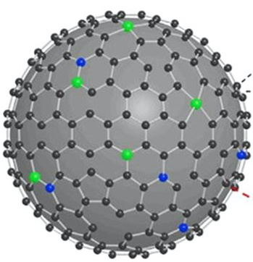
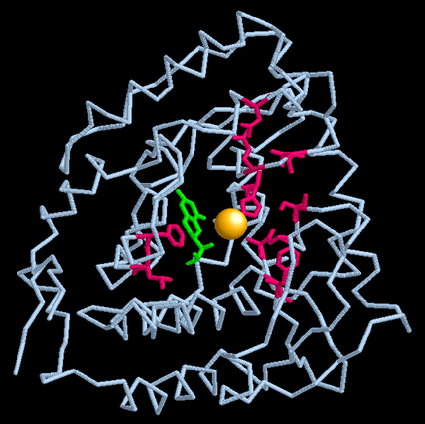
Carbon Nanomaterials as Electrocatalysts
Single Atom Catalysts as Enzymatic Mimics
Dr. Seth Burkert, Chemistry

Slide 13
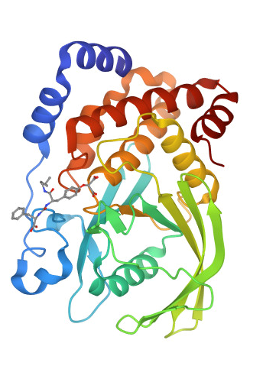
Design and Synthesis of Inhibitors of Protein Phosphatases
Protein Tyrosine Phosphatase 1B
Overexpression results in a variety of
medical conditions such as type 2 diabetes and obesity
Inhibitor can decrease this activity
Dr. Anne Reeve, Chemistry

Slide 14
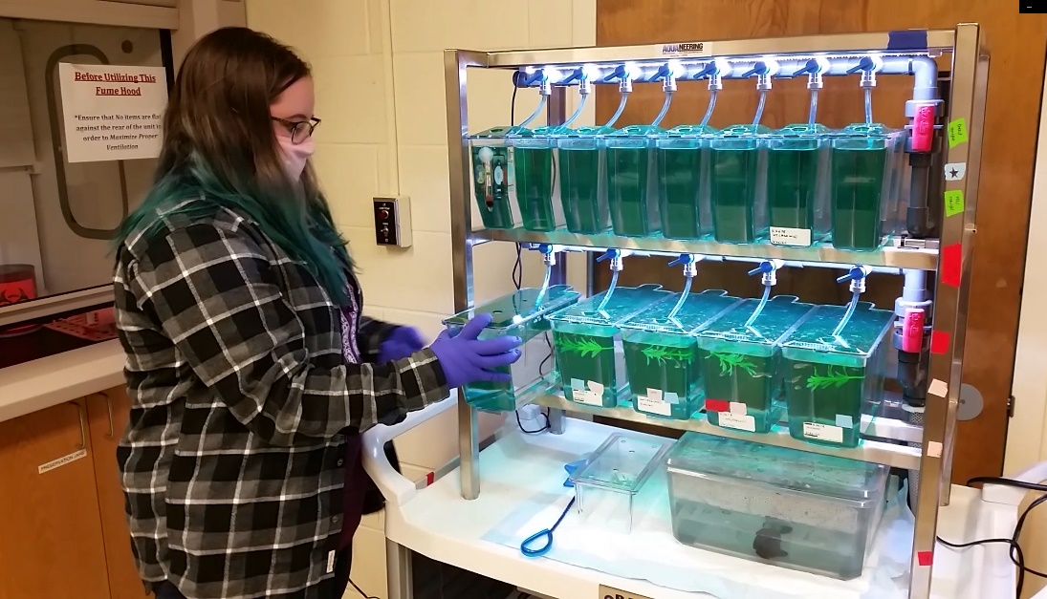

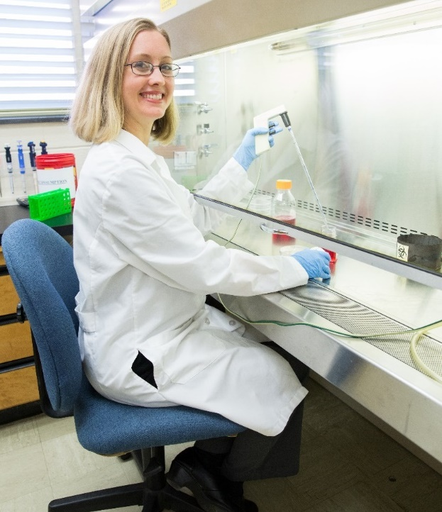
Glial Biology and Development
Research models:
Zebrafish
Cell Culture
Oligodendrocyte development
Cell signaling pathways that promote remyelination after injury
Dr. Jennifer Ness-Myers, Biology

Slide 15
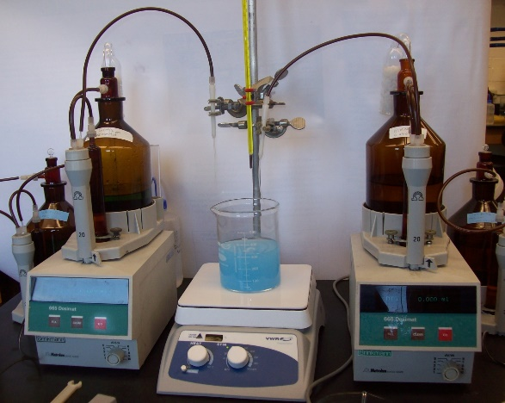
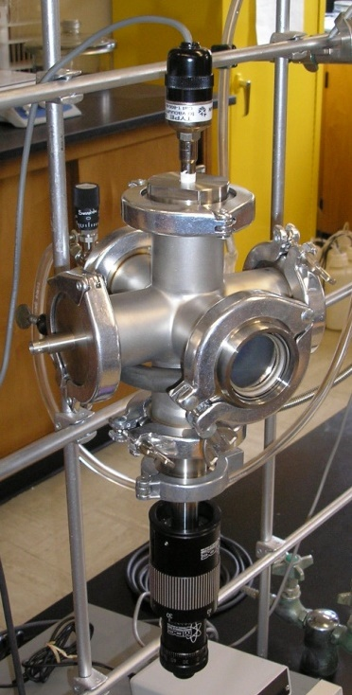
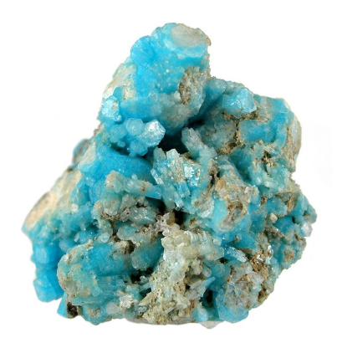
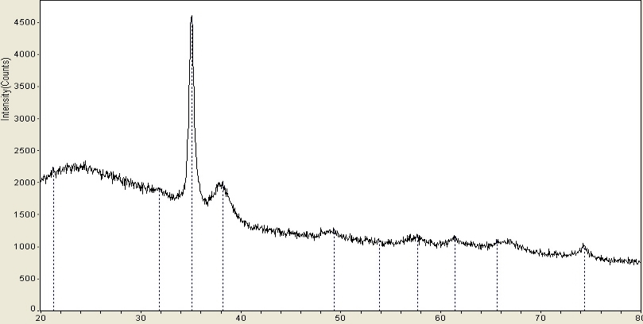
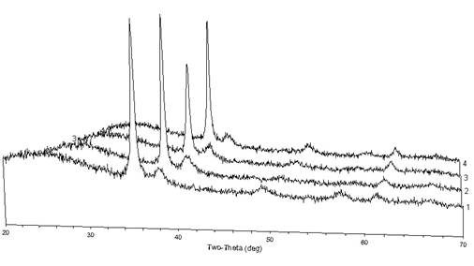
The Synthesis and Characterization of
Minerals and Analogs
Double-jet Reactor
Glow-Discharge Plasma as a Synthetic Method for Inorganic Materials
Dr. Richard Schaeffer, Chemistry

Slide 16
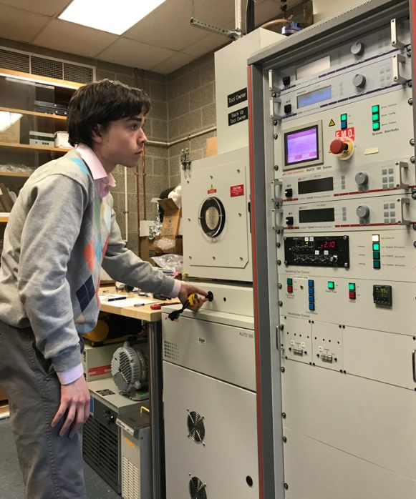
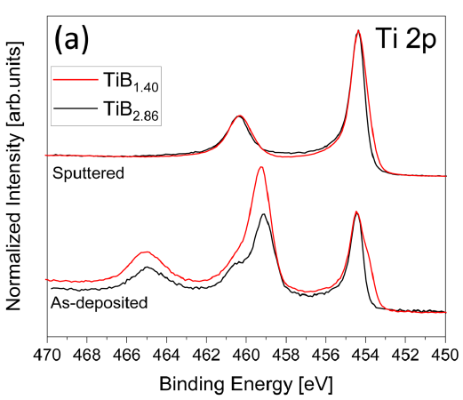
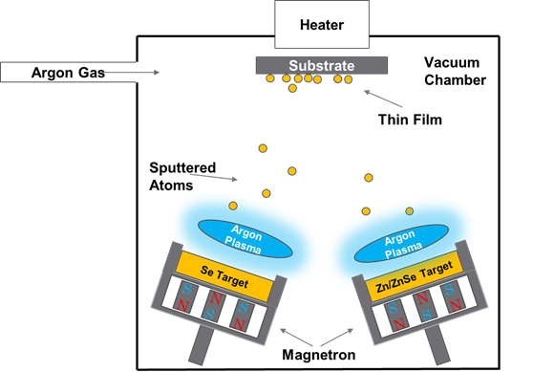
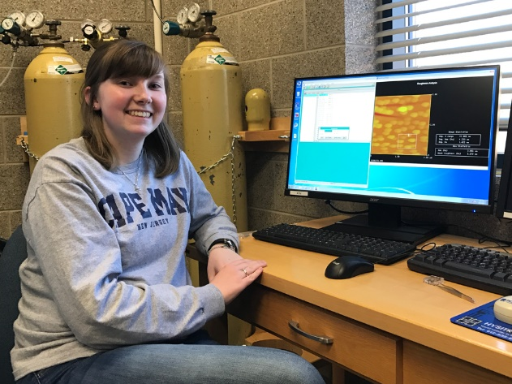
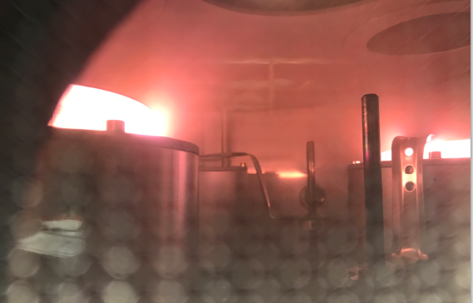
Vacuum deposition of thin films and their characterization
Dr. Niklas Hellgren, Physics

Slide 17
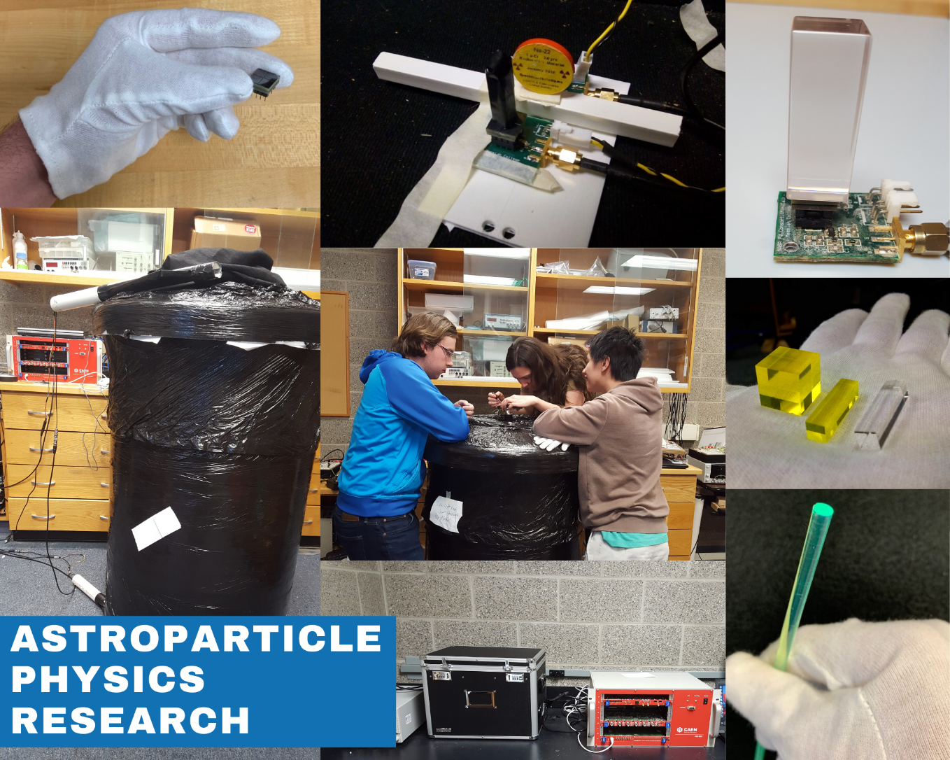
Astroparticle Physics Research
What is the nature of the Dark Matter? What particle is it?
Two experiments at Messiah University:
URIDA experiment (dark photon search)
SNIPE-HUNT experiment
(axion search)
2. What processes in the universe drive the highest energy cosmic and gamma rays?
Dr. Abaz Kryemadhi, Physics

Slide 18
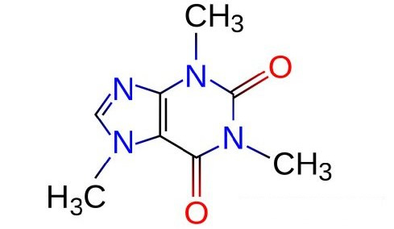
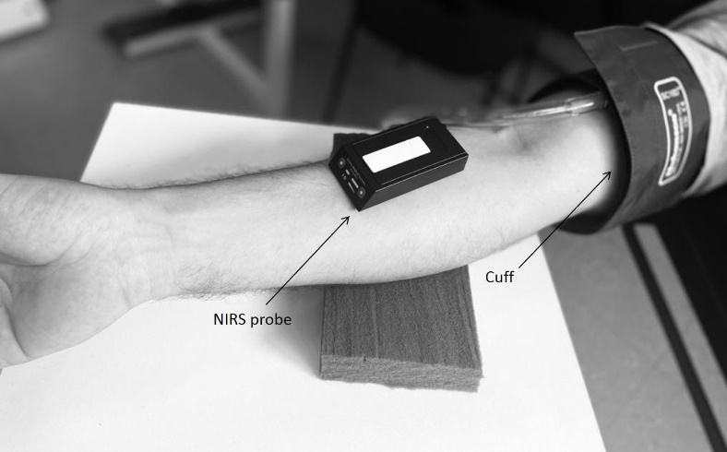
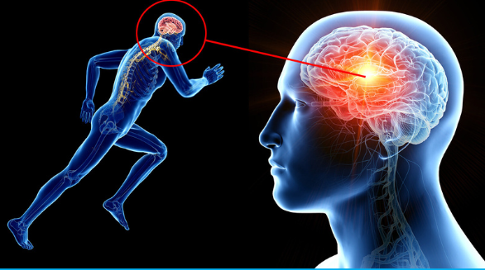
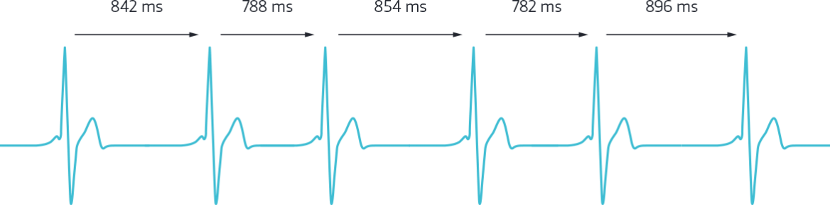
Nutrition and athletic performance
Dr. H. Scott Kieffer, Exercise Science

Slide 19
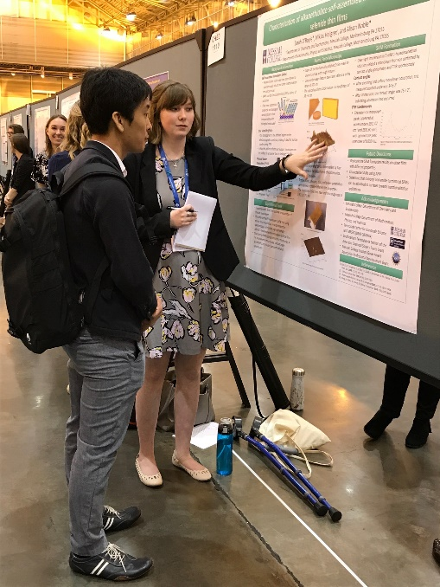
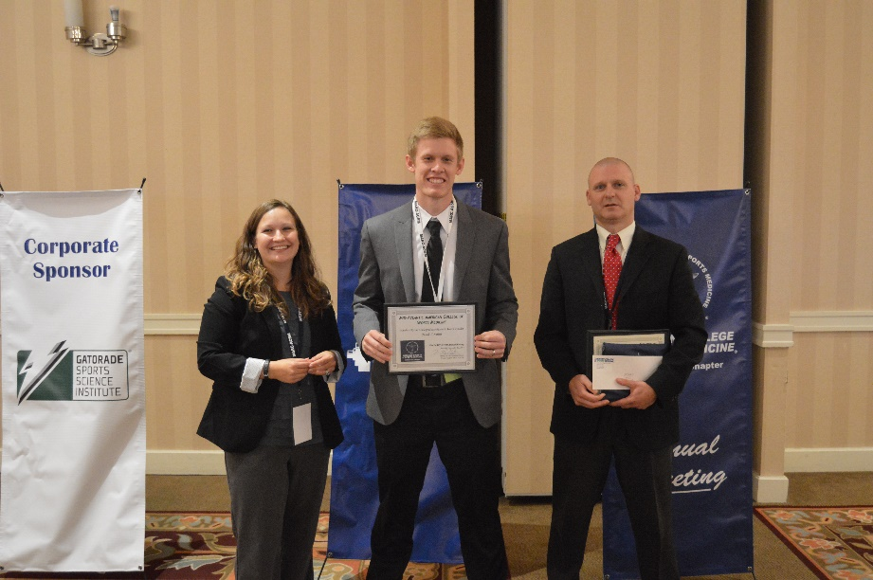
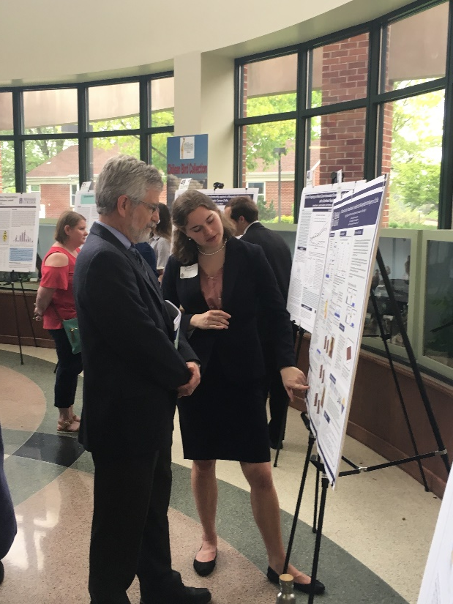
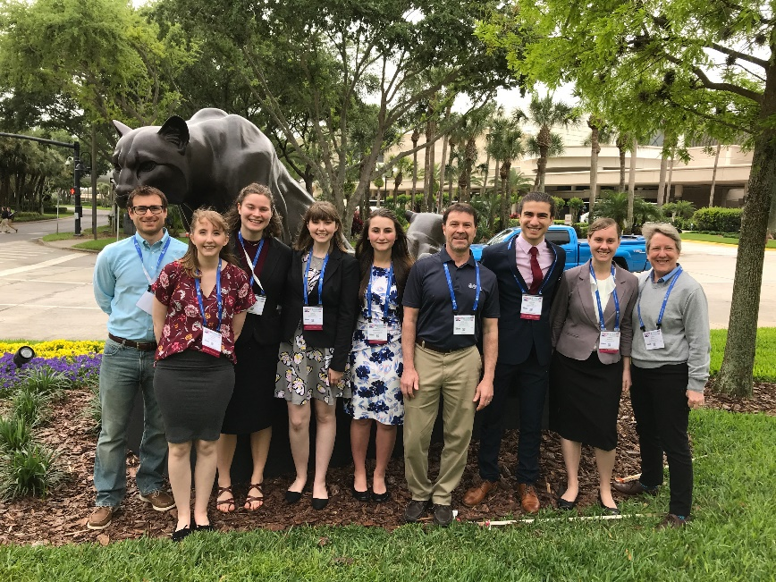
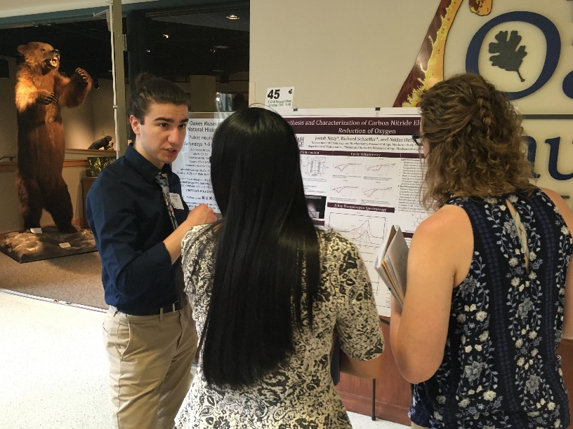
Research Presentations

Slide 20
