Slide 1
Jadu XForms
Training session

Slide 2
Log into Jadu
For training purposes, we will use our training server so we don’t break anything on the live site.
Go to http://jadutraining.messiah.edu/jadu
Sign in using your MC username and password
Note: Outside of training, when you are modifying or creating a new form, please use the standard www.messiah.edu/jadu url to access the live site.

Slide 3
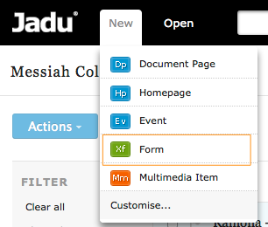
Create a new form

Slide 4
Create your opening page
Give your form a title
Place it in a category
Assign Metadata (Google description)
Allow Unregistered users (yes!)
Resume at start (your choice)
Display progress bar (your choice)
Require ReCaptcha (this protects the form from ‘bots’ filling it out)
General form instructions: fill out if you have instructions for the overall form

Slide 6
First page
Complete the Page Title, Page Instructions if needed and then save your page.

Slide 7
Add questions
Click “Edit questions” to add or edit existing questions.

Slide 8
Add your first question
Select the “Component” from the drop down. You can chose from many options, but you’ll probably use these the most frequently:
Text Field: fill in a one line blank
Text Area: fill in several lines, good for an essay or comment box
Check Box: select multiple items
Radio Button: select only one item
Drop down: select from a long list which is not displayed until clicked

Slide 9
Complete first question

Slide 10
Add other related questions
You can follow the same procedure and add other questions as needed. As another option, you can click “Form Template” to see / apply a list of commonly used form items.

Slide 11
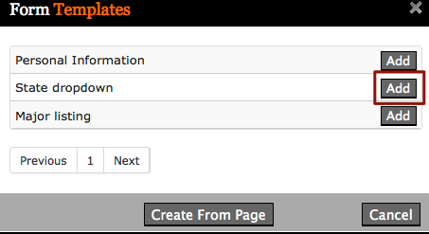
Adding Form Templates
Form templates are time saving because they are already built for you.
In this example, you will add a state dropdown so you don’t have to type every state in the form.

Slide 12
Adding email confirmations
Click on “Actions” in the tab level to create the email confirmation that you will receive when someone fills out the form AND to create the email the respondent will receive when they request an email confirmation.

Slide 13
Edit existing action

Slide 14
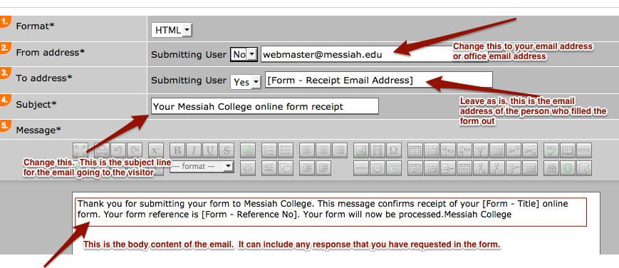
Specify “To” email and email content

Slide 15
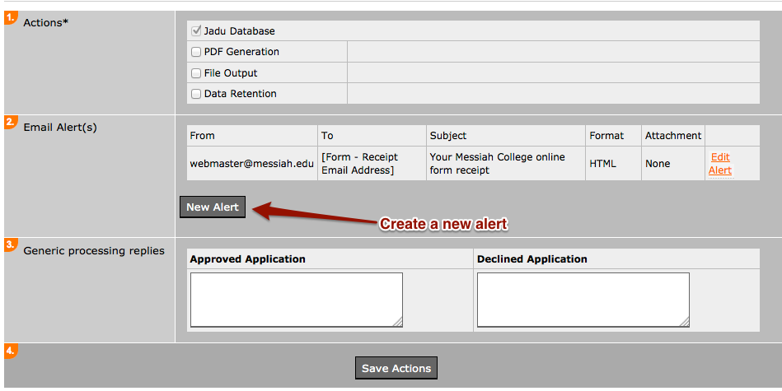
Specify “From” email and pull in questions and responses

Slide 16
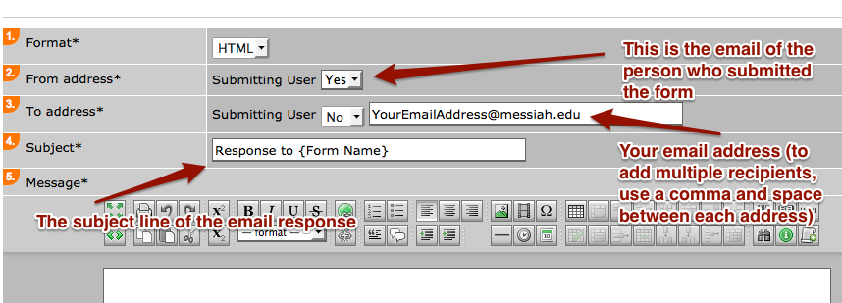
Specify “From” email and pull in questions and responses

Slide 17
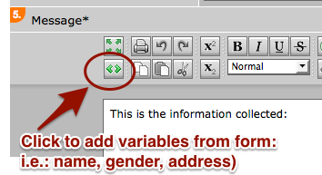
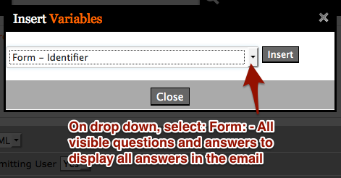
Specify “From” email and pull in questions and responses

Slide 18
Find a form

Slide 19
Find a form to edit or create new form

