Slide 1
Accessing your LIVE Student Account

Slide 2
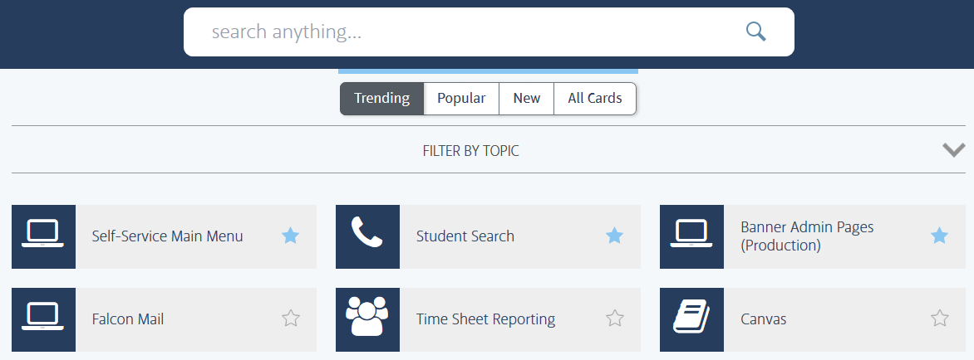
Step 1: Log into FALCONlink
Type “self service” in the search bar

Slide 3
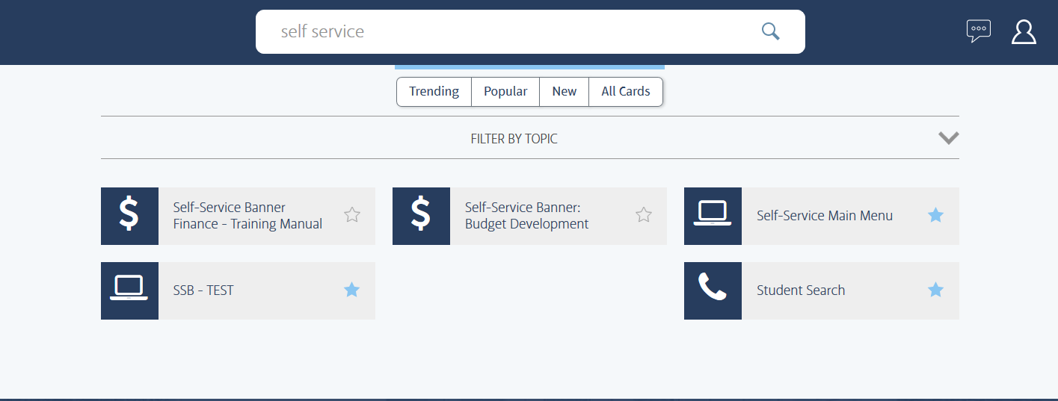
Step 2: Select “Self-Service Main Menu”

Slide 4
Step 3: Navigate Self Service
Click on “Student Services”
Click on “Student Account”

Slide 5
Step 4: Select Student Account options
Account Summary by Term, Account Detail for Term, Account Detail Listing: provide financial information about your student account.
eBill: view your bill and pay online.
ID Card Account Detail: view Dining Dollar and Falcon Dollar transactions and balance.
Request Student Account Refund: request your credit balance by check or direct deposit.

Slide 6
Account Detail Listing
Account Detail Listing is the best screen to keep track of live transactions without waiting for the actual bill.
View all transactions by date including charges, payments, financial aid, and current balance.
Please note that financial aid will not show here until the date it pays onto student account (the eBill is the best place to view anticipated financial aid and balance due)
Student

Slide 7
Account Detail For Term
Account Detail for Term allows you to view all transactions for one specific semester.

Slide 8
Account Summary by Term
Account Summary by Term allows you to view all transactions for all semesters in one academic year.

