Slide 1
Giving Parents Access to Your eBill

Slide 2
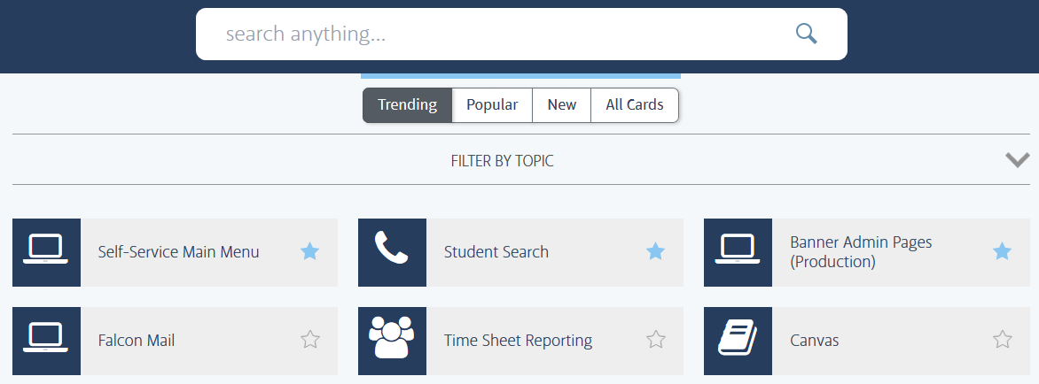
Step 1: Log into FALCONlink
Type “eBill” in the search bar

Slide 3
Step 2: Select “CashNet eBill”

Slide 4
Step 3: Add New Authorization
Click “Add New” to authorize your parents to have access to your invoices and make payments.

Slide 5
Step 3: Add New Authorization
“Parent or Authorized User Log-in or PIN” is created by student. This can be something easy to remember who the user will be.
E.g. Dad, Mom, etc
Leaving these set in the default setting will allow the Authorized User to receive email notices and view new invoices.

Slide 6
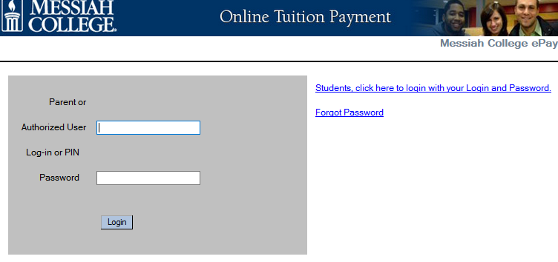
Step 4: Parents Use PIN to Access Account
Your parent will receive an email like below. They will see the PIN that you gave them along with a Temporary Password.
Parent click on this link to log in
Parent will use provided PIN and Password in the email to login. The first time logging in will allow parent to set a new password.

