Slide 1
International Service INFO night!

Slide 2
Introductions
Emily Callon—International Missions Coordinator
nismoffice@messiah.edu
Ashley Sheaffer – Director of Co-Curricular Service Learning
asheaffer@messiah.edu
Rhonda King—Nicaragua Trip Advisor

Slide 3
Northern Ireland
Trip Advisors: Chad Frey
In Country: March 5—13
Mission:
Outreach and relationship building with students at Lurgan Jr. High School
Community outreach through local church, Richhill Preysbeterian, Invest N.I., and sports ministries

Slide 4
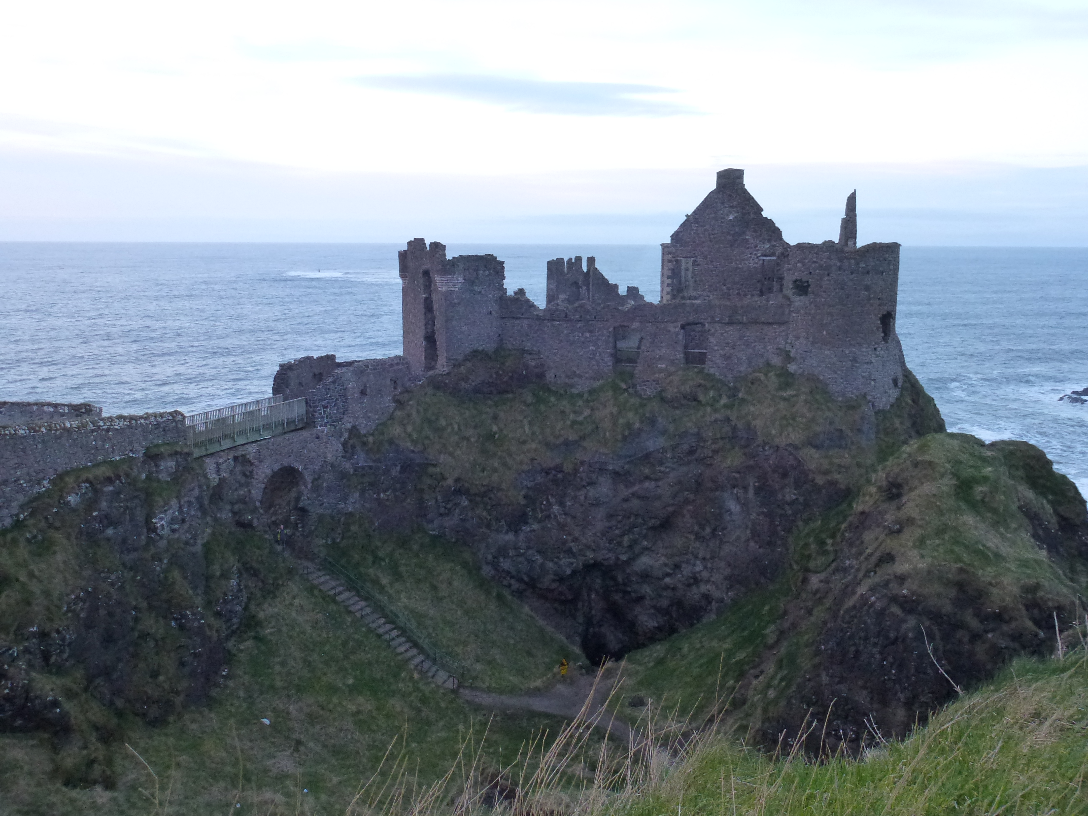
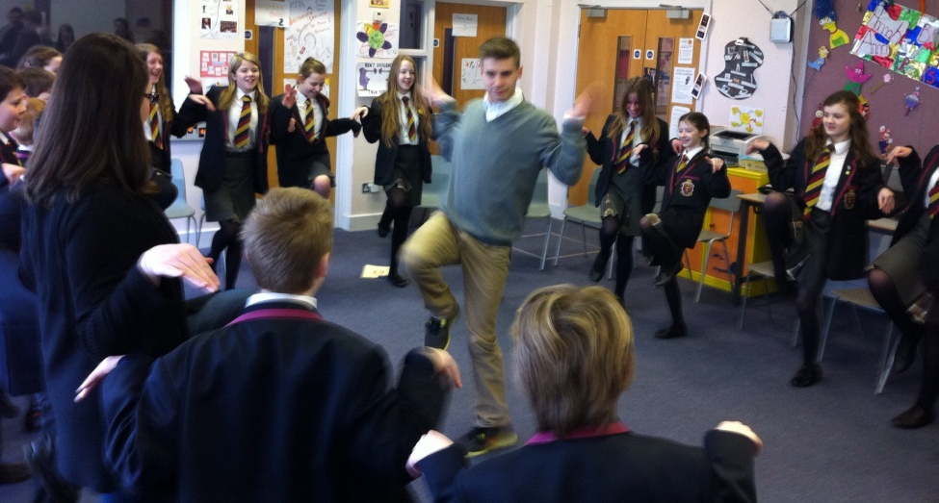
Northern Ireland

Slide 5
Nicaragua
Trip Advisors: Rhonda King
In Country: May 28—June 4
Organization: Food for the Hungry (https://fh.org/)
Mission:
Education
Provide supplemental work to the schools: VBS programs, maintenance to physical space, and other needs

Slide 6
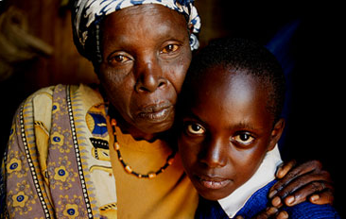
Nicaragua

Slide 7
Trip Roles
Trip Advisors (Mentioned above, per trip)
Faculty/Staff
Team Leaders
Two students per trip
Facilitate team development
Enroll in SERV 231 & 232
MUST PICK UP DESCRIPTION
Team Members

Slide 8
Team roles
Team Development
Fundraising
Administration
Social Media

Slide 9
Expectations & Responsibilities
Participate FULLY in Fundraising Efforts
Pay, in full, amount required for trip, including additional $100 deposit directly to the Business Office
Participate in Team Training Meetings & Events
Trip Orientation Night
Letter Stuffing Party/Prayer Over Letters
Training Chapels in February-March, Thurs. @ 9:30 am
Complete all necessary materials in a TIMELY MANNER

Slide 10
Application Process
Review Position Description
Apply Online or Paper Copy
If notified, then Sign-Up for Interview
Notes:
Direct students to quarter-sheet hand out about Application process and links provided.

Slide 11
Cost & raising support
Fundraising
Responsible for Raising Individual Funds
Financial & Prayer Support Letters
Fundraising Events— ex., Canoe-a-thon
Cost Breakdown
Travel & Airfare
In-country Expenses (Food, Water, Shelter, etc.)
Project Expenses
Northern Ireland
$1,000
Trip, TBD:
$1,500
Nicaragua
$1,700

Slide 12
For more information…
Agape Center’s Website:
http://www.messiah.edu/info/21018/international_opportunities
Contact Emily Callon:
nismoffice@messiah.edu

Slide 13
Questions?

