Slide 1

Commuter Students Living in Community
Welcome Week 2019
Notes:
*Julie*

Slide 2
Introductions
JP Edmunds, Coordinator of Student Involvement & Leadership Programs
Julie Cline, Director of Student Involvement & Leadership Programs
Madi Trautman, Commuter Student Liaison
Notes:
*Julie*

Slide 3
Resources & Information
Because you are a vital part of the Messiah College community, there are Commuter Services available to assist you
Commuter Services is housed in the Office of Student Involvement & Leadership Programs (SILP). If you have any questions or concerns, please contact JP Edmunds (jedmunds@messiah.edu)
JP oversees Commuter Services (Larsen 228)
You can also direct general commuter-related questions, concerns or suggestions via e-mail to Commuter Services at commuterservices@messiah.edu.
Notes:
*Julie*

Slide 4
Madi Trautman
Commuter Student Liaison
Commuter Services offers a special Commuter Student Liaison to help represent and address commuter needs, communicate relevant and timely information, and provide specific programming designed to enhance the overall commuter experience. Cate is a fellow commuter student and is in her second year at Messiah.
Notes:
*Madi*

Slide 5
Commuter Council
SGA dedicates funds directly to Commuter Students
We are looking for creative people with fun ideas to help plan events for specifically Commuter Students
To get involved, please contact Cate Cutting: commuterservices@messiah.edu.
Notes:
*Madi*

Slide 6
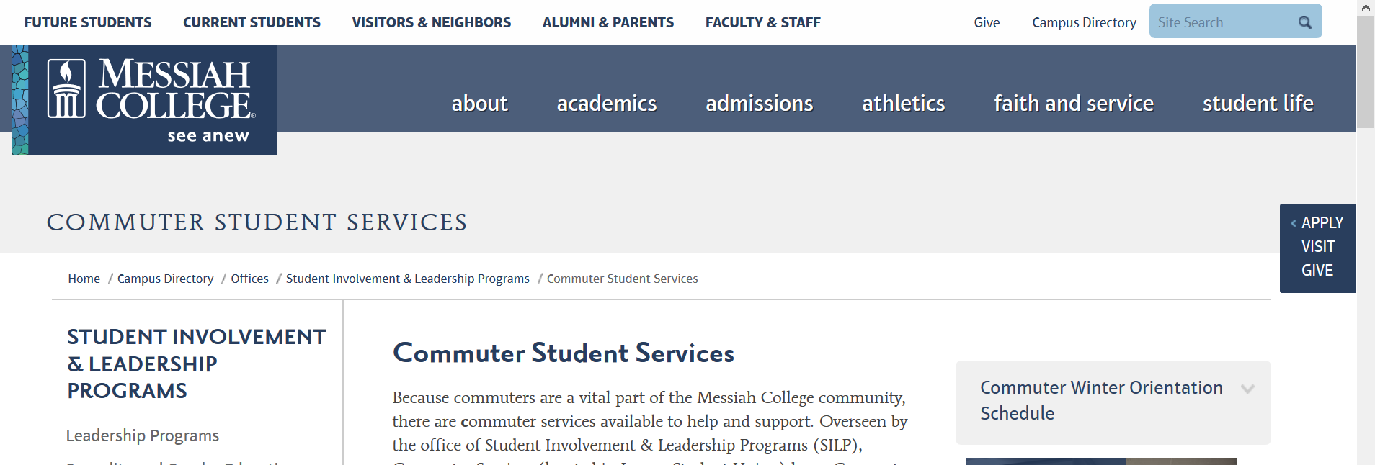
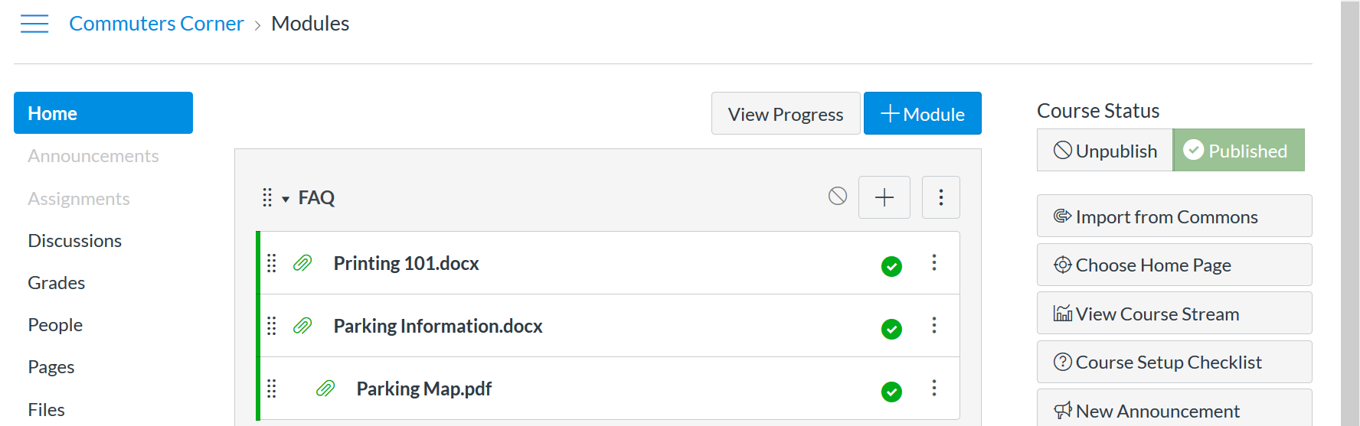
Online Resources
SILP Website
Canvas
Notes:
*JP*

Slide 7
Ways to Get Connected & Involved
As a commuter student, it sometimes takes a little more work to make connections. The easiest way to meet other students is to get involved in campus life.
Attend Orientation Group activities.
Student-run clubs and organizations have something for everyone!
Come to the Student Club, Involvement & Service Fair on Thursday, Sept. 5, 2017 from 5:30–8 p.m. at Larsen Student Union to get all the information you need.
Also, check out Rec Sports where you'll find information about intramurals and other related physical activities:
www.messiah.edu/recsports
Notes:
*JP*

Slide 8



Other great ways to stay informed about what’s happening
Commuter Student Canvas page
Posters in the campus center, Larsen Student Union, commuter lounge, stairwells
Mass e-mail announcements
The Swinging Bridge (magazine)
The Pulse (Messiah College’s media hub)
WVMM 90.7 (The V: Messiah College’s FM radio station)
Messiah College Facebook page and The Pulse Facebook page or Twitter account
Chapel announcements
Instagram
Word of mouth
Notes:
*JP*
Add insta

Slide 9
Join us!
Commuter Student Social
Saturday, August 31st, 4:00pm
Charles Frey Commuter Lounge
Notes:
*JP*

Slide 10
Commuter Lounge
The commuter lounge is located on the lower level of Mountain View Residence Hall
This lounge includes study and lounge space available for individuals and groups
Additionally, the lounge stocks:
  a microwave
  hot/cold water (PLEASE TURN OFF COFFEE POT)
  Refrigerator
  Kitchenette
  lockers for commuters
Free coffee, tea, and hot cocoa are also available.
Notes:
*Julie*

Slide 11
Commuter Lounge
WHILE SHARING THIS SPACE, WE COMMIT TO:
Honoring the dignity of each person
Respecting this space and the property of others
Practicing personal and academic integrity
Working toward mutual understanding
The pursuit of these ideals by each member of the Messiah College community enables our community to flourish as well as engage our educational mission to the glory of God.
Notes:
*Julie*

Slide 12
NO NUTS!
We have a commuter student with a severe airborne-allergy to all nuts, so the Commuter Lounge is a nut-free facility
Notes:
*Julie*

Slide 13
Commuter Lounge
Keep your area tidy & clean up after yourself prior to leaving the lounge
Remove food from the refrigerator before the weekend -- any unlabeled food will be thrown out
Note that the college is not responsible for your personal belongings
Respect other members of this community by using headphones when appropriate
Note that the lounge hours are from 6am to 12am
As a part of the Commuter Community, please acknowledge that all people & property in this space will be treated respectfully.
Notes:
*Julie*

Slide 14
Lockers
Lockers are assigned on a first-come first-served basis.
Please e-mail Ashley Barnes at abarnes@messiah.edu
Or come to the SILP Office (2nd floor Union)
Notes:
*Julie*

Slide 15
Commuter Student Meal Plan
Three tiers are available:
  $150
  $200
  $250
All three plans can have money added to them
All plans include a 10% discount at campus dining
Meal Plan Requests are available using the Housebook database system located on the Messiah College Portal, Student Tab, under “Student Quicklinks”
Notes:
*JP*

Slide 16
Commuter Parking
All undergraduate commuters MUST register for parking using the Student Parking & Registration Form by the August 29th Deadline.
Forms can also be found at the Falcon Exchange located at Eisenhower 243.
Please return completed form to the Falcon Exchange located at Eisenhower 243 (open Monday through Friday 8 a.m. to 4 p.m.). Visit the Falcon Exchange webpage for more details:
www.messiah.edu/falconexchange
Notes:
*JP*

Slide 17
Commuter Parking
All undergraduate commuters MUST register for parking using the Student Parking & Registration Form online
Forms can also be found at the Falcon Exchange located at Eisenhower 243.
Be courteous and respectful in adhering to parking policies
Notes:
*JP*

Slide 18
Commuter Rideshare Services
Want to save on gas and share your commute with other Messiah commuters?
We provide a online rideshare platform that can assist you in making connections with other commuters wanting that too.
You must be a current Messiah College student to access this service. The website has all the details you need to register:
www.messiah.edu/ridesharelocal
Notes:
*JP*

Slide 19
Weather Delays & Closing Details
Wondering if the snow or ice is causing a campus delay for classes?
Will the campus even be open?
You can sign up for Messiah text alerts online and receive a text when decisions are made or call the emergency line at 717-691-6084.
www.messiah.edu/info/20297/students
Notes:
*JP*

Slide 20
Chapel Requirements
The chapel requirement is seven (7) per semester for commuter students
Petitions to the requirement may be made via Self-Service (under the Student tab) through October 31, 2016
Only petitions submitted for valid reasons as listed below will be approved:
  Academic internship/field placement/practicum that conflicts with chapel times
  Off-campus work equaling 25+ hours per week. (On-campus jobs do not apply. Supervisors are to arrange your schedule to accommodate the chapel requirement.)
  Ongoing (two weeks or more) medical issues/emergencies. (Must include a doctor’s prescription/note, and extent of exemption will be assessed on a case-by-case basis.)
  Parental obligations.
Notes:
*JP*

Slide 21
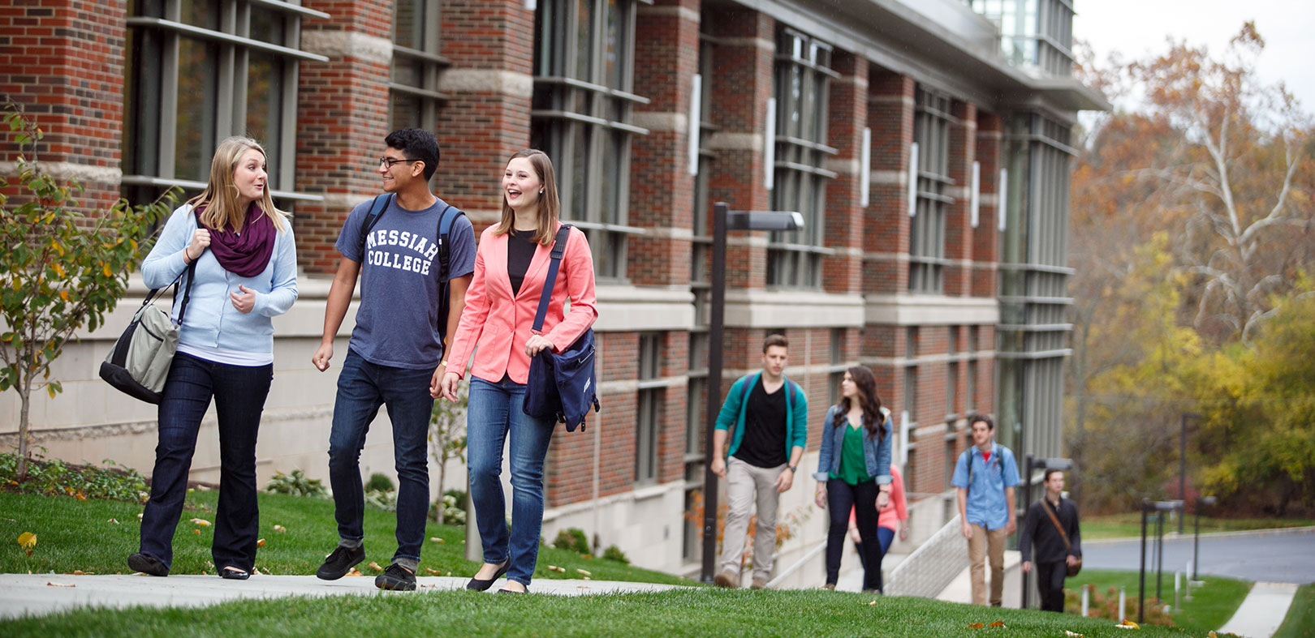
Community Covenant
https://www.youtube.com/watch?v=YGjpPBtfmbo
Notes:
*Julie*

Slide 22
Questions?
Notes:
*Julie*

Slide 23
Candlelight Service of Worship
Join us tonight at 6:30 p.m. in Hitchcock!
Notes:
*Julie*

