Slide 1
Department of Psychology
Messiah College

Slide 2

What is Psychology?
Psychology is “the systematic/scientific study of the behavior and mental processes of humans.”
http://graduate.carleton.ca/wp-content/uploads/psychology2.jpg

Slide 3
Why Study Psychology?
“A human being is a microcosm of the universe, ‘a rare example of God’s power, goodness, and wisdom, and contains within…enough miracles to occupy our minds’.” – John Calvin
“I praise you because I am fearfully and wonderfully made;
your works are wonderful,
I know that full well.” Psalm 139:14 (NIV)
“But Jesus did not trust Himself to them, because he knew all men and needed no one to bear witness of man; for he himself knew what was in man.” John 2: 24, 25 (RSV)

Slide 4
You know you are a psychology major if you:
Enjoy working with people from a variety of backgrounds and dispositions
Enjoy research involving human capacities, behaviors, and developmental stages
Can tolerate ambiguity and are open to behavioral complexities
Enjoy observing others and seeking to understand their behaviors and thoughts
Are interested in a sophisticated knowledge of self and others
Desire to apply your learning to yourself and others
Notes:
Diane

Slide 5
You might be a Biopsychology major if…
You are fascinated by the brain
You want to understand human behavior from a biological perspective
You don’t mind a little chemistry!
You collect items that have pictures of brains
You own jewelry with the chemical structures of neurotransmitters

Slide 6
Distinctives of Psychology at
Messiah College
Excellent faculty-student relationships and mentorships
Emphasis on training students to write adeptly
Students are able to perform research or practica with dedicated and approachable faculty.
Provides advanced video recording equipment in interview rooms
Provides a flexible Psychology program which enables students to explore minors

Slide 7
Distinctives of Biopsychology Program at Messiah College
Access to faculty in both the Biology and Psychology departments
Emphasis on providing top-notch research experiences to prepare students for graduate/medical school
Two options for course scheduling based on your individual interests
Excellent research facilities with equipment such as EEG monitoring, biometrics, scanning electron microscopes, etc.
Opportunity to take the Human Anatomy course with human cadaver dissections

Slide 8
Psychology Curriculum at
Messiah College
Students will take courses that are theoretical, clinical, and experimental nature
Many courses combine academic theory with hands on experience
Students consider connections between subject matter and a Christian world view

Slide 9
Biopsychology Curriculum at Messiah College
Students take courses in the Biological, Chemical and Psychological sciences
Many courses offer hands-on laboratory experiences
Connections between course material and the Christian faith are made in every course
Two tracks
  Track A – Medical/Graduate Study
  Track B – Applied Health Professions (OT, PT, etc)

Slide 10
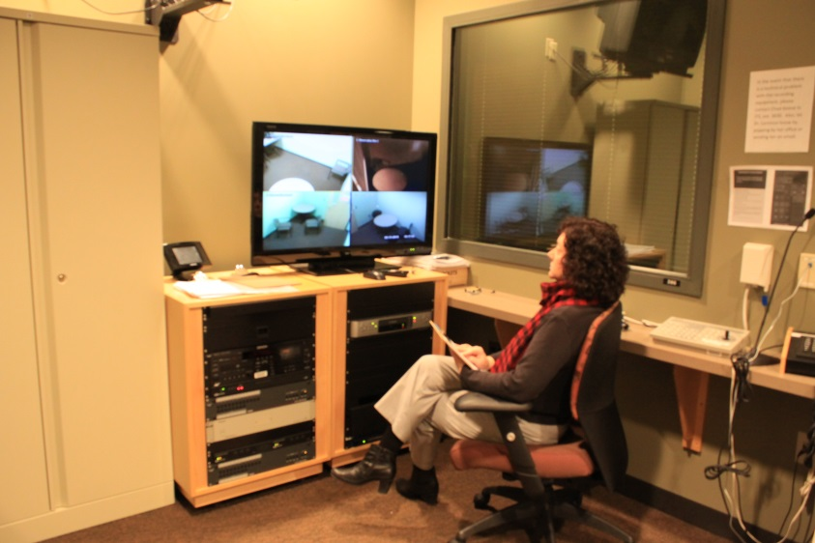
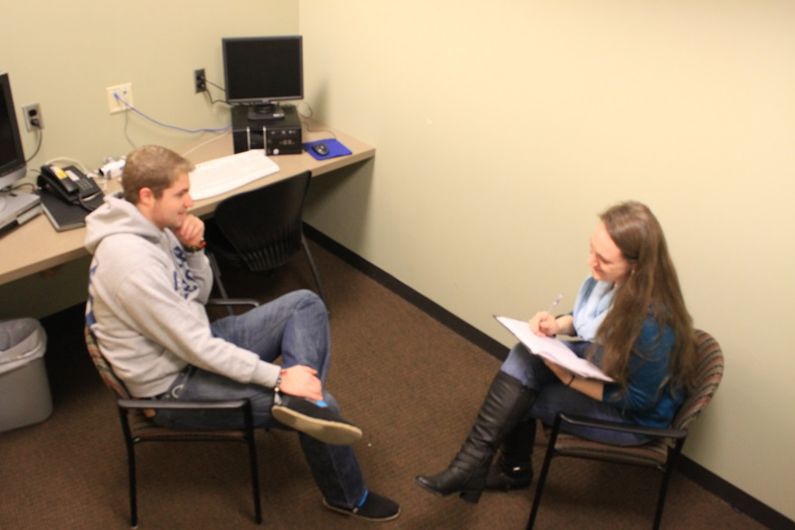
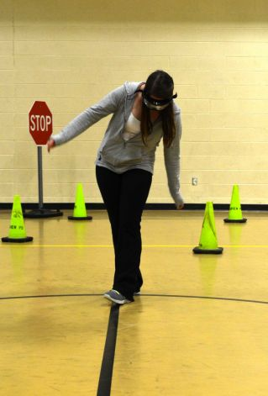
Developing Skills in Psychology
Messiah students may work with faculty on research projects, independent studies, practicum, or participate in a Departmental Honors Project.
Psychology students have access to interview rooms including advanced video-recording equipment.
Students may use perception-altering goggles in class, devices such as a pulse oximeter to do research, and SPSS (IBM software) to perform statistical analysis.

Slide 11
Psychology at Messiah College: Degrees offered
Bachelor of Arts (B.A.) in Psychology
  ● with optional Clinical Concentration
Bachelor of Science (B.S.) in Psychology
B.S. in Biopsychology
  ● including two possible tracks
B.S in Biopsychology with M.S.O.T.
  3/2 program with TJU
Psychology Minors
  ● Psychology
  ● Pre-Counseling and Therapy (interdepartmental with HDFS)
Notes:
Include on this slide BS in Biopsychology (M.S.O.T.)

Slide 12
Psychology at Messiah College:
B.A. vs. B.S.—
What’s the Difference???
a B.A. in Psychology:
Prepares students for placements in entry-level positions in the helping professions or for graduate school in many sub-fields of psychology including clinical.
a B.S. in Psychology:
● Designed for students who intend to work in a field that has a stronger emphasis on science or math or for those who wish to pursue graduate studies that lean more towards research and the sciences.
Notes:
Include Biopsychology slide- equity.

Slide 13
Psychology at Messiah College:
Division of Credits for the B.A. & B.S. in Psychology
Notes:
Evaluate the necessity of this slide.

Slide 14
Psychology at Messiah College:
B.S. in BIOPSYCHOLOGY
Biopsychology is the scientific study of the biology of behavior and mental processes (such as learning, memory, perception, attention, motivation, emotion, and cognition).
Our B.S. in Biopsychology is a collaborative effort with the Department of Biological Sciences.
Prepares students who are interested in fields such as:
  ● Medicine ● Psychopharmacology
  ● Psychiatry ● Neuropsychology
  ● Cognitive neuroscience ● Behavioral genetics
● Occupational therapy ● Comparative Psychology
3 + 2 Occupational Therapy Program with Thomas Jefferson University
Notes:
Last bullet point should be emphasized.

Slide 15
Psychology at Messiah College:
Division of Credits for the B.S. in Biopsychology
Notes:
Possibly omit this slide.

Slide 16
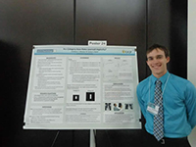
Psychology at Messiah College:
Opportunities in Psychology
Join Minds Matter, which educates students on mental illness by reaching out through service to the local community
Become a member of Psi Chi, the national honor society for Psychology
Biospychology majors may become members of Sigma Zeta, the national honor society for Biology
Connect faith and academics through the completion of service learning projects related to psychology
Research, write, and present with faculty members
Complete a Senior Major Honors Project
Gain additional experience through an internship or practicum related to Psychology
Notes:
Expand on this.

Slide 17
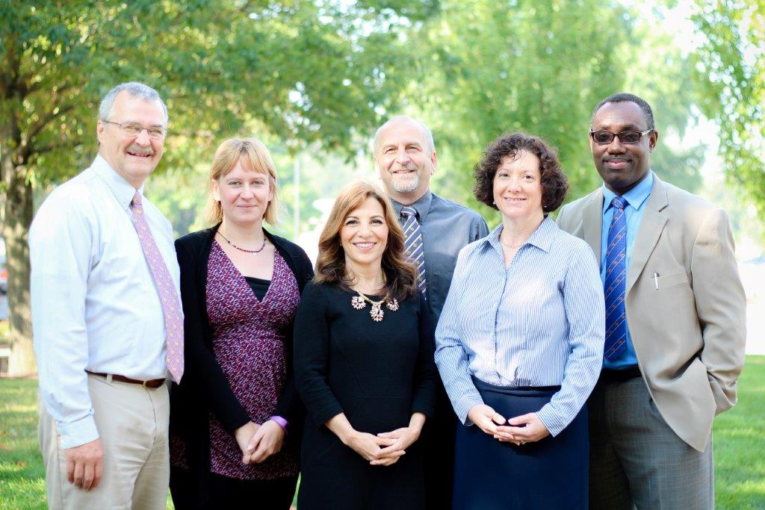
Messiah College Psychology Department Faculty
The faculty are passionate about their fields
Bring enthusiasm and a variety of engaged teaching styles to the classroom
Psychology professors have expertise and experience in a variety of disciplines from therapy to experimental research to biopsychology.
All professors are knowledgeable and well-suited to the profession of education.

Slide 18
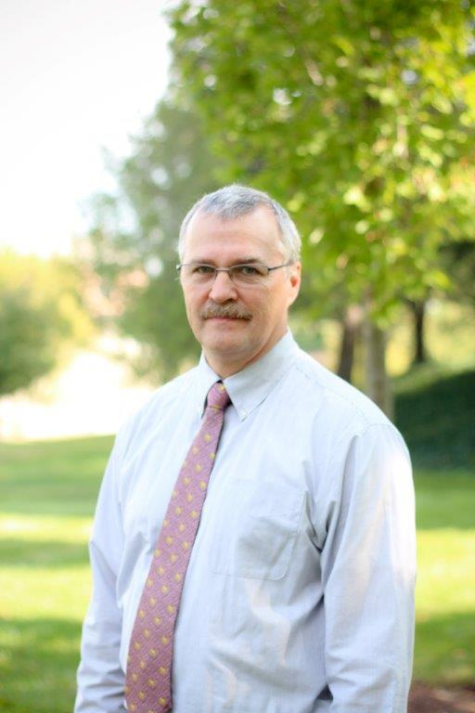
Psychology at Messiah College:
The Faculty
Research & Professional Interests:
Fathering & Divorce
Cross-Cultural Studies
Technology & Its Psychological Effects
Communication technology and European Youth
Frequently Taught Courses:
Opportunities in Psychology
Cognition
Experimental Psychology
Cross-cultural Psychology
Statistical Methods in Psychology
John Bechtold, Chair
Ph.D. Kansas State
1988
Notes:
Preceding this, include general statement about faculty and pic. For this slide, update the photo.

Slide 19
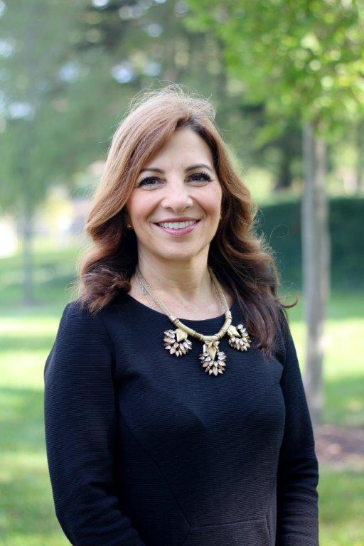
Psychology at Messiah College:
The Faculty
Research & Professional Interests:
Attraction
Performance in Sports
Frequently Taught Courses:
Introduction to Psychology
I/O Psychology
Introduction to Social Research
Community Psychology
Diane Brockman
Ph.D. Temple
2002
Notes:
Preceding this, include general statement about faculty and pic. For this slide, update the photo.

Slide 20
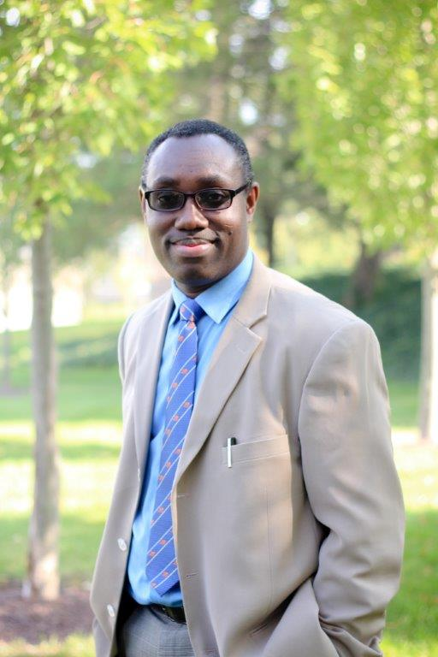
Psychology at Messiah College:
The Faculty
Henry A. Danso
Ph.D. University of Western Ontario
2009
Research & Professional Interests:
Immigration Attitudes
Intelligence Test Performance
Reconciliation
Research on Sleep and Dreams
Personality and Denomination
Frequently Taught Courses:
Introduction to Psychology
Social Psychology
Lifespan Development
Topics: Research

Slide 21
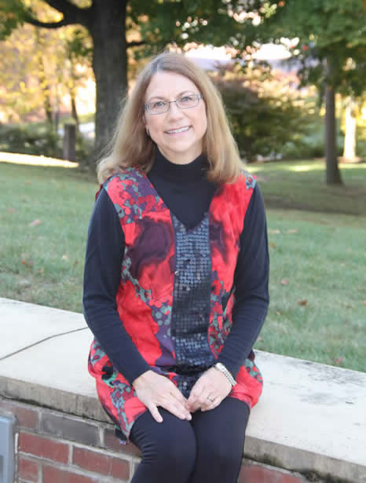
Psychology at Messiah College:
The Faculty
Research & Professional Interests:
Integration of Psych & Theology
Christian Higher Education
Faculty Development in Classroom
Frequently Taught Courses:
Psychology Seminar
Women and Men in American Society
Rhonda Jacobsen
Ed.D. Temple University
1984

Slide 22
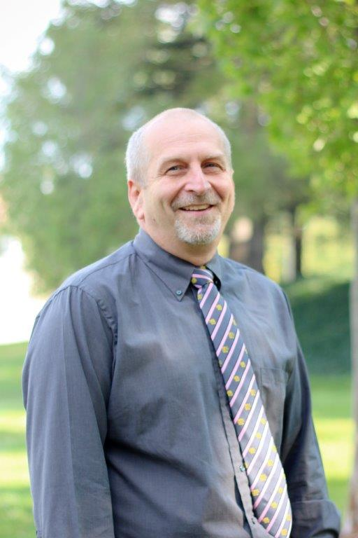
Psychology at Messiah College:
The Faculty
Research & Professional Interests:
Impact of Technology on Families
Impact of Work on Adolescent Development
Body Image and Sanctification of the Body
Frequently Taught Courses:
Counseling Theories
Abnormal Psychology
History and Systems of Psychology
Adolescent Development
Charles D. Jantzi
Psy.D. Wright State
2004

Slide 23
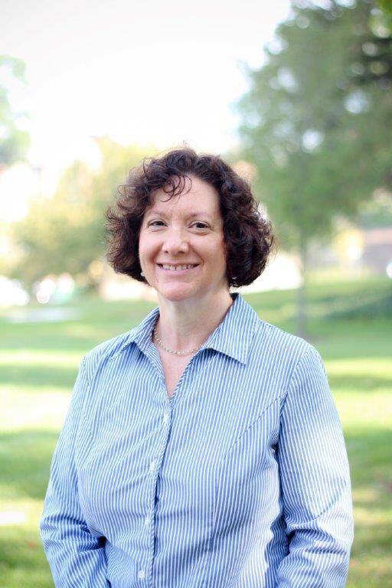
Psychology at Messiah College
The Faculty
Research & Professional Interests:
Body Image and Sanctification of the
Body
Forgiveness
Posttraumatic Stress Disorder
Frequently Taught Courses:
Counseling Techniques
Psychological Testing
Abnormal Psychology
Group Dynamics
Valerie A. Lemmon
Psy.D. Philadelphia College of Osteopathic Medicine
2007

Slide 24
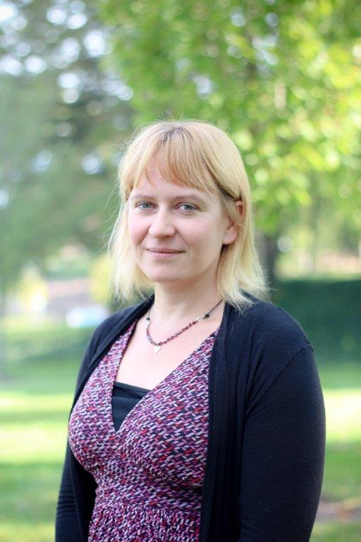
Psychology at Messiah College:
The Faculty
Research & Professional Interests:
Posttraumatic Stress Disorder
Stress & Health
Addiction
Frequently Taught Courses:
Biological Basis of Behavior
Drug & Alcohol Addiction
Stress & Health
Sensation & Perception
Jennifer Thomson
Ph.D. University of North Carolina
2009

Slide 25
Psychology at Messiah College:
Examples of Student Entry-Level Positions
Case Manager
  Organizes and coordinates services and supports for patients, such as children with mental health problems and their families; oversees the overall medical, personal, and social service needs of the patients
Counselor
  Provides professional help in coping with life issues such as emotional and relationship difficulties; helps clients and families evaluate their patterns of problem solving and develop more effective ones
Psychiatric Assistant
  Assists counselors in non-therapeutic therapy. Monitors and assesses patient progress to ensure that patient treatment objectives are met. Records and reports patient information. Implements patient treatment plans and selects patient activities
Notes:
Condense these three slides into one?

Slide 26
Psychology at Messiah College:
Examples of Student Entry-Level Positions
Crime Victim Advocate
  Counsels victims and their families; accompanies and supports victims through the criminal justice process; provides community education, training and consultation
Social Worker
  Provides social services and assistance to improve the social and psychological functioning of children and their families and to maximize the family well-being and academic functioning of children
Therapeutic Staff Support
  Provides one-to-one behavioral health interventions to a child or adolescent with a serious emotional disturbance in order to prevent more restrictive services or out-of-home placement and to promote age-appropriate psychosocial growth

Slide 27
Psychology at Messiah College:
Examples of Student Entry-Level Positions
Rehab Specialist
  Manage the components important in the rehabilitation process of individuals with physical and mental disabilities. They help prevent fragmentation and gaps in services to people seeking to move from psychological and economic dependence to independence
Residential Counselors
  In charge of group homes. The residents of these homes include emotionally disturbed, developmentally disabled, and mentally ill youth and adults. People in homes supervised by residential counselors may also have physical problems, but the problems that keep them from being self-sufficient are primarily mental or emotional
Home Care Aide
  Helps elderly, disabled, and ill persons live in their own homes or in residential care facilities instead of in a health facility

Slide 28
Psychology at Messiah College:
Graduate Schools of Recent Grads
Messiah College Masters of Arts in Counseling
American University
Brandeis University
Biola University, Rosemead School of Psychology
Evangelical Theological Seminary
MCP Hahneman University
Indiana University of Pennsylvania
Jerusalem University College
Millersville University
New York University
Regent University
Shippensburg University
Wheaton College Graduate School
State University of NY at Albany and Brockport
Temple University
Thomas Jefferson University
Towson University
Mount St. Mary’s College
University of Central Florida
University of Connecticut
University of Maryland
University of Wisconsin
University of Texas
St. Joseph’s University
Virginia Polytechnic Institute and State University
William and Mary School of Law
Notes:
Include this slide, but condense into one.

Slide 29
Entry Level Career Options for Biopsychology Students
Pharmaceutical Sales
Science Writer
Lab Animal Care Technician
Forensic Science Technician
Health Educator
Medical Technician
Research Assistant
Neuroimaging Assistant
Psychometrist

Slide 30
Career Options for Biopsychology Majors Requiring Advanced Degrees
Graduate Programs
  Neuroscience, Experimental, Cognitive
Medical School
  PA, DNP, Veterinary, Optometry, Dental,Pharmacy
Occupational/Physical Therapy
Neuropsychology
Audiology
Neuroimaging
Public Health
Neuromarketing
Addition Counselor

Slide 31
Recent Research Projects Presented by Psychology Majors at Research Conferences
Opioid Growth Factor reduces the expression of conditioned fear in an animal model of PTSD
  Paige Hopkins, Jacinta Davis, Lauren Spreen and Dr. Jennifer Thomson
Evaluation of Body Appreciation based on Attachment Relationships
  Ashley Burkett, Josiah Haws, Nicole Harland, Katrina Williams, Leeann Shearer and Dr. Valerie Lemmon
Relationship Satisfaction on College Campuses
  Hope Blackford, Megan Hendricks and Dr. Diane Brockman

Slide 32
Department of Psychology
Messiah College
http://www.messiah.edu/departments/psychology

