Slide 1
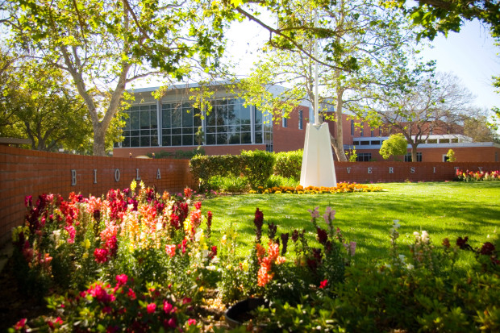


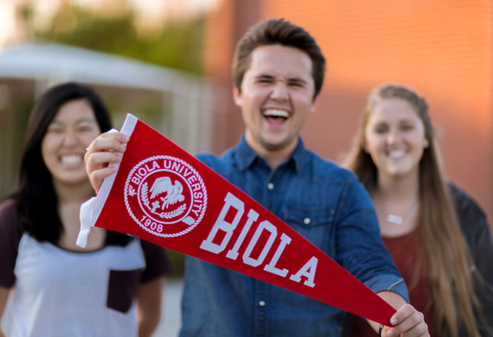
Partner Institution Fact Sheet
Private Christian university
Bachelor’s, master’s, and doctoral degrees
3,700 undergrads + 2,100 grads
biola.edu
La Mirada, California
MISSION STATEMENT
The mission of Biola University is biblically centered education, scholarship and
service — equipping men and women in mind and character to impact the world for the Lord Jesus Christ.
Popular Majors:
Business
Education
English
Film Production
Journalism
Nursing
Public Relations
Studio Arts
NCAA Division II
Baseball
Basketball
Cross Country
Golf (Women’s)
Soccer
Softball
Swim/Dive
Tennis
Track & Field
Volleyball (Women’s)
Water Polo

Slide 2
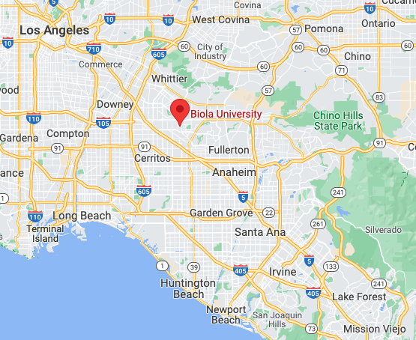
La mirada, CA
By car:
25 mins to Anaheim, CA
50 mins to Los Angeles, CA
50 mins to Long Beach, CA
55 mins to Huntington Beach, CA
Population: 48,800
Info: cityoflamirada.org
Biola University Campus Life
Intercultural Clubs and Events
Special interest clubs
Intramural sports
Service opportunities
Multiple chapel services per week
Prayer groups Tuesday & Thursday
4 ministry groups
Annual theme for chapel focus
biola.edu/spiritual-development/

