Slide 1
Club Advisor Training
Student Engagement • Fall 2024
Notes:
Curtis/Ashley
Welcome

Slide 2
Advisor Training Overview
Basic Overview
Handbook & Guidelines
General Expectations
SGA & The Office of Student Engagement (OSE)
Forms, Finances, Event Requests, & FalconLink Calendar
Volunteers, Compliance, Facilities, & Travel
Advisors, Coaches, & Contact Information
Notes:
Curtis - Acknowledge recognized, chartered, or executive groups
Express gratitude for their support. Without advisors these key co-curricular activities that enhance leadership development, retention, and whole person formation - would not be a success

Slide 3
Student Engagement Purpose Statement
To foster student engagement, provide intentional leadership development experiences, and encourage thoughtful dialogue while promoting a sense of belonging for all students
Notes:
Curtis

Slide 4
Advisor Handbook
It is required that you read and understand the advisor handbook each year that you advise a club/organization.
We are currently in the process of still updating the manual for this year, but we should have this finalized soon.
Notes:
Curtis - Advisor handbook outlines the purpose of advisors and their responsibilities. It also has the expectations that advisors should be aware of for their students. Additionally, it has useful resources for students and advisors. This will be emailed to you all this week and it will also be up on our website

Slide 5
Organizational Management Expectations
Page 7
Please take special note of this section & review information
1. OneDrive 2. Club Email 3. Canvas 4. Club Grading 5. Advisor Trainings 6. FalconLink Calendar
Notes:
Curtis -- OneDrive (Make sure student leaders are uploading club documents to their club email’s OneDrive.) Club Email- Club leaders should check their email 3x a week at least and should respond promptly to emails. Canvas- Clubs should upload their monthly reports to Canvas, and can view their club grading on Canvas. Club grading- 4 elements of club grading: 1. Fiscal responsibility (follow OSE policy regarding P-Card, tax-exemption, etc.), 2. Community Engagement- (events for student-body at-large, evaluated according to monthly report), 3. Attendance (Students must attend necessary club workshops and Student Senate) 4. Communication - Advisor training- New advisors must attend advisor training. Advisor training must be renewed every 3 years. FalconLink Calendar- Component of campus engagement, must complete the form for events.

Slide 6
General Expectations
Advisors “offer direction for student organizations according to their student leaders’ goals.”
You can suggest, advise, challenge, support, counsel
You are not to direct or supervise
Ultimately you are supporting the student experience in something they willingly participate.
There are some things you they will need you to do on behalf of them– please pay attention to these requests!!!
E.g. key requests, purchasing, speaker approvals, etc.
Notes:
Curtis - Advisors serve to give students actions to achieve their goals, tools to explore possibilities, and encouragement for new ideas. YOU support THEM. They drive the ship, you help keep it oiled. This means you can’t give direct orders, or kick people out, etc. You normally shouldn’t even be running your meetings. The students get to decide what and how - you help them determine what KIND and how MUCH. Bumpers on a bowling alley– you aren’t the bowler or the ball
And remember that this is something students do in their FREE TIME. They should take it seriously, but ultimately this is a recreational activity.

Slide 7
The Office of Student Engagement
Supports students and student organizations across campus.
Resources include:
Club policy input
Common club resources
Advising direction
Club status transitions
Finances & forms
Notes:
Curtis - consultation on resources, policies, and forms… Any changes in leadership or status

Slide 8
Forms
Please note that almost all forms you should need are on the Club Forms Page of the OSE website
Before reaching out to SGA or OSE, please look here first as there are ample resources to be found here
Notes:
Curtis

Slide 9
Finances
Purchasing Expectations
Advisors should use their p-cards
OSE holds p-card training for SGA card
Advisors are responsible for One$ource training through the finance office at Messiah
Advisors are responsible for purchasing any large expense items for their teams
This includes paying event supplies., club gear, etc.
Note: This should all be in accordance with the SGA Governance manual policies
Notes:
Ashley

Slide 10
Event Request
We require all clubs to complete an event request form
This form will be less involved, but is required
You can find a list of events that need your signature by going directly into Dynamic Forms (found in Falcon Link)
Take note that dances, fundraisers, films, and guest speakers all require an additional request form
This form should be filled out for ALL club events, except for regular club meetings.
Notes:
Ashley

Slide 11
Guest Speaker Policy
Please make sure your students fill out the Club Special Events Form whenever they have a guest speaker.
Once the guest speaker is approved, all speakers will need to fill out and sign the Guest Speaker Policy and Agreement Form.
Guest speaker forms MUST be submitted and approved before advertising the event.
Please note that Messiah University does not approve student organizations to invite political candidates, or their political party or campaign designees, to speak on campus.
Notes:
Ashley

Slide 12
FalconLink Calendar & This Week at Messiah
We encourage clubs to post their events, open to all students, on the Student Events Calendar. Please fill out this form here to have your event on the calendar. All events on the calendar will automatically be added to the This Week at Messiah email.
This serves you by encouraging students to attend your events
This serves us by giving us an idea of what is happening on campus
This serves campus and the student body by helping them structure their involvement
Notes:
Ashley

Slide 13
Volunteers
Any outside members of our community (not currently on Messiah’s payroll) helping with events are considered Volunteers (teacher, regular speakers, coaches, refs, etc.)
They will need to register as a volunteer on campus which includes completing the three part background check through our HR department
As an Advisor or support person, you will be responsible for ensuring that all paperwork is completed prior to a volunteer starting
Notes:
Ashley

Slide 14
Travel
Please review specific handbook guidelines for travel expenses and how they can or cannot be funded by the institution .
It is always preferable to use Campus Fleet Vehicles for institutional travel.
When using personal vehicles on behalf of a club-sponsored event, you must have participants sign waivers.
Notes:
Curtis

Slide 15
Contact Information
SGA - Club Details, Finances, & General Club Matters
- sgaorganizations@messiah.edu
Student Engagement - Club Policy Input, Advisor Resources, Club Status Insight, & Calendar Updates
studentengagement@messiah.edu
ckurtz@messiah.edu
Notes:
Curtis

Slide 16
Final Note
Please review with your students each slide on the How To Presentation on our website
This has important updated information for all basic club functioning guidelines
Notes:
Curtis

Slide 17
Thank you! If you are a club sport advisor or coach, please stick around for the additional club sport information.

Slide 18
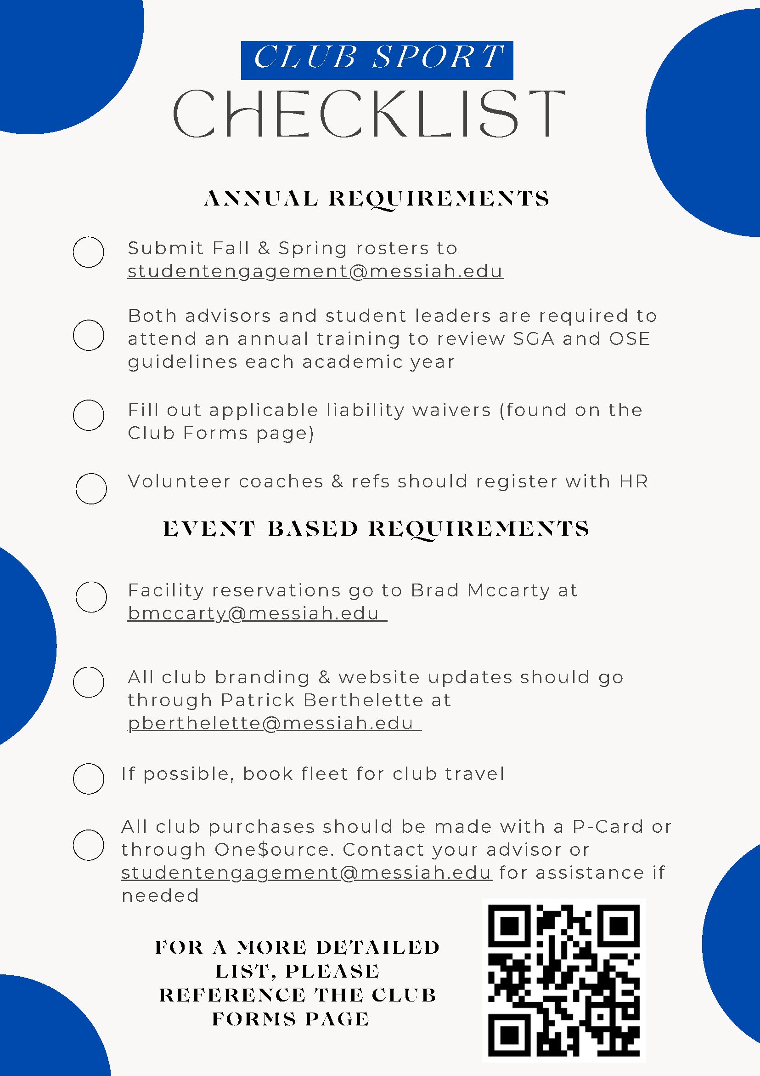
Checklist
Please look over the checklist form you have. A more in-depth checklist will be available on the Club Forms page for you to reference if you have questions.

Slide 19
Compliance
Each sport needs to have a roster excel sheet with the following information:
Full name of athlete
Athlete’s school year
Sport played
Indication that the club sport waiver has been filled out
This spreadsheet is due to the Office of Student Engagement once per semester. Please email to studentengagement@messiah.edu.

Slide 20
Facilities
Priority according to SGA and Club Sport Manual Priority “A” Messiah University Academic Activities
Priority “B” Messiah University Sponsored Events
Priority “C” Intercollegiate Activities
Priority “D” Student Programs Sponsored Events
Priority “E” Open Gym
Priority “F” General Public/External Events
Intramurals will have their schedule of each month finalized by the first of the month
Contact Brad McCarty

Slide 21
Coaches & Advisors
Some of the waivers are on dynamic forms and some are on the Club Forms page.
Athletes select their advisor in a drop down menu and complete the waiver.
Upon completion the advisor receives an email receipt.
It is the advisor’s responsibility to keep track of who has and has not completed the waiver.
Notes:
Abby

Slide 22
Contact Information
SGA - Club Details, Finances, & General Club Matters
Student Engagement - Club Policy Input, Advisor Resources, Club Status Insight, Calendar Updates, Waiver, & Compliance
Brad McCarty– Facilities Rico Plummer – Specific questions about Compliance
Notes:
Abby

Slide 23
Thank you!

