Slide 1

Orientation for Pre-Student Teaching Experiences

Slide 2
Teacher Education Program
Mission Statement
The mission of the Messiah University Teacher Education Program is to develop professional educators who ...
facilitate the learning and development of others consistently,
reflect on thoughts and actions deliberately,
apply essential knowledge effectively,
learn continuously,
care for people compassionately, and
serve God and society faithfully.

Slide 3
Student Goal Orientations
Performance
I’ll do what it takes to avoid a bad evaluation.
I’ll work for a good evaluation.
Approach
Avoidance
I challenge myself to be the best educator I can be.
I don’t want to be bad at what I do.
Mastery
Notes:
The work of early goal theorists contrasted two types of goal orientations: mastery, which is a desire to acquire additional knowledge or master new skills, and performance, which is a desire to demonstrate high ability and make a good impression. Recent works of goal theorists have incorporated a second dimension of goal orientations: approach and avoidance.
Mastery-oriented goals are defined in terms of a focus on learning, mastering the task according to self-set standards or self-improvement. It also encompasses developing new skills, improving or developing competence, trying to accomplish something challenging and trying to gain an understanding or insight.
Performance-oriented goals represent a focus on demonstrating competence or ability and how ability will be judged relative to others. For example, trying to surpass normative performance standards, attempting to best others, using casual comparative standards or striving to be the best in a group or even avoiding judgments of low ability or appearing dumb are examples of performance-oriented goals.
Approach-oriented goals are goals in which individuals are positively motivated to look good and receive favorable judgment from others.
Avoidance-oriented goals are goals in which individuals can be negatively motivated to try to avoid failure and to avoid looking incompetent.
Performance goals versus mastery goals
Cross country example– I started with a performance goal. I would walk in the woods so I would be well-rested and I could look good at the end. I didn’t care how my time was as long as I looked like I had a strong kick at the end. I’d tell myself in the woods, “Pass me now because I won’t let you pass me later.” My coach later instilled in me a mastery goal. “Own the hills.” Work hard on the hills. I still think about that. I don’t get passed on uphill climbs too often. I might not look so strong at the end, but I own the hills.
For teaching and learning examples, let’s hear what one of our colleagues has to say about getting students to value the process of learning more than the performance on the test. And, in case you’re skeptical that mastery oriented students exist, listen to one of our grad students (who is also an undergraduate alum) talk about her drive to learn more than is required for the assessment.

Slide 4
Student Goal Orientations
Do not focus on the scores!
Focus on the learning opportunities!
Mastery over performance goals
Growth mindset!
Think like an emerging professional!

Slide 5
Purpose of the Pre-Student Teaching Experience
Students in this pre-student teaching field experience are placed in their respective certification areas.
This is the student’s second field experience.
Students in this field experience are enrolled in and have taken curriculum and instruction courses including courses on inclusion practices and working with English language learners.
The goal is to give Messiah pre-student teachers a variety of teaching-related experiences and to provide a service to the classroom teachers and students with whom they work.

Slide 6
Guidelines for School Visits
Students need to be in school every Tuesday/Thursday when Messiah University and the school are in session, including for teacher in-service days, ACT 80 days, and parent/teacher conferences.
  Refer to field experience calendar for required days
Students must carry Driver’s license and printed copies of TB result and 3 Clearances:
  Criminal Background Check
  PA Child Abuse History Clearance
  FBI Background Check
Arrive at school before school begins and stay until required as noted in handbook
Be actively engaged in classroom activities

Slide 7
Guidelines for School Visits
(Cont.)
Students may participate in other school activities; however, they do not count toward field hours, and you are not allowed to miss college classes to do so
Plan for and teach a minimum of three lessons for formal observations and two lessons for video assignments
Maintain attendance log and submit hours via Qualtrics survey
Report Absences

Slide 8
Reporting Absences
All absences must be reported by the student when they occur (not at the end of the semester)
Please report your absence to TEP by following these steps:
1. Go to Falcon Link
2. Search for Teacher Education Program - Student
3. Click on tab
4. Select Field Experience Absence Form
*university supervisors and mentor teachers will receive notification
Failure to report absences is a breach of the Academic Integrity Policy
Make-up day is ________ (noted on field experience calendar)

Slide 9
Student Assignments
Mandated Reporter Training
  Complete and submit completion certificate in Canvas
ICI Self Assessment Inventory
  Complete ICI–PRE Rating at beginning of semester, submit in Canvas
  At end of semester, complete the ICI–POST Rating, submit in Canvas
In-School Schedule Report
  Complete after 2nd week in school and submit in Canvas
Teacher Education Website Quiz
  Complete the quiz on important information found on the TEP Website: messiah.edu/teacher
Weekly Goals and Reflection Assignment
  Submit a thoughtful reflection and plan for professional growth in Canvas on Friday of each week

Slide 10
Student Assignments (Cont.)
Video/Self monitoring Assignment
  Plan lessons and video-record teaching two times; complete accompanying reflection forms; upload into Canvas
  *These 2 videos of teaching are different and separate from formal observations
Surveys
  Complete Pre-Student teaching check in Survey
  Complete Attendance/Activity Report Survey (submit your logged hours via this Qualtrics survey at end of semester)
Portfolio Artifact
  Create an artifact that represents your teaching experience and learning
Update Your Resume

Slide 11
Guidelines for Video
Student Self- Monitoring Assignment
Instruction may be for large or small group.
Two videos, self-reflections and lesson plans must be uploaded ONLY to Canvas using Yuja.
Directions are on Canvas.
The university supervisor will be able to view the videos by going into Canvas.
Due dates are indicated on the Semester at a Glance and the field experience calendar.
Do NOT post these videos on any public site such as YouTube or Facebook.

Slide 12
Student Planning Expectations
The pre-student teacher must write an instructional plan for all lessons the student will be teaching.
Written plans are to follow the Messiah University Instructional Planning Model. (As taught in Instructional Design, Art ,HPE, or Music Curriculum & Unit Instruction courses.)
The mentor teacher is a resource for the pre-student teacher. The teacher may provide the student with preliminary plans, teaching materials, curriculum documents, or other relevant resources to assist the student in effective planning.
The pre-student teacher is to submit plans to the mentor teacher 48 hours in advance of teaching. *
If the plans are not submitted in a timely manner or are not satisfactory by the time the student is to teach, the mentor teacher may not allow the pre-student teacher to teach.

Slide 13
Supervision Requirements:
Mentor Teacher
Ongoing informal verbal feedback to the student
Two teaching observations (large or small group) with written feedback on the Performance Observation Report form
  Send completed observation forms via email to the student, the university supervisor, and the field experience coordinator (jmcgill@messiah.edu)
Input into the Final Evaluation during conference with the university supervisor at the end of the semester

Slide 14
Supervision Requirements:
University Supervisor
Mark Weekly Goals and Reflections using rubric and comment in Canvas.
Mark the following assignments as Complete or Incomplete and give feedback in Canvas: ICI-PRE Rating, Artifact, Resume, ICI–POST Rating
Initial Visit (within first two weeks) to classroom for an informal observation and meeting with mentor teacher and student using the Initial Visit Performance Observation Report form for written feedback.
One formal observation with written feedback using the Performance Observation Report form and conference with student
  Email completed forms to student, mentor teacher, and field experience coordinator (jmcgill@messiah.edu) within 24 hours of observation.
Conference with student after completion of Video Assignments
Final Evaluation
  Communicate plan for final evaluation process with mentor teacher
  Complete Messiah Final evaluation with input from mentor teacher
  Conference with student and submit electronic form via Falcon Link

Slide 15
Guidelines for Live and Video Performance Observations
Ideally, the university supervisor and mentor teacher are observing the pre-student teacher doing some whole group instruction.
Soon after the formal observation the mentor teacher/supervisor will conference with the student and review the observation form.
The pre-student teacher’s written instructional plans for any teaching must be reviewed by the mentor teacher and available for the university supervisor to review at the time of the observation/review of videos.

Slide 16
Final Evaluation
The Electronic Final Evaluation Form is to be completed by the university supervisor with input from the mentor teacher.
The Final Evaluation Form will include a recommendation regarding the student’s readiness for student teaching. This recommendation will be shared with the student and the student’s academic department.
The Final Evaluation Form is to be submitted by the university supervisor to the Teacher Education Program Office via Falcon Link at the end of the semester.
The Final Evaluation Form will be available to the student in Falcon Link after TEP Office review at the end of the semester.

Slide 17
Dos Don’ts
Professionalism
Dress like a professional no matter how others dress.
Properly address professionals in person and in email.
Maintain student confidentiality.
Know your district well.
Exhibit confidence and teachability.
Develop rapport with other professionals in the building.
Be resourceful.
Think like an emerging professional with growth mindset.
Tell your mentor teacher that you’re not sure you want to be a teacher.
Even consider a personal relationship with a student– EVER.
Use your cell phone or complete homework during the school day.
Complain about your workload, your students, your university, your cooperating teacher…

Slide 18
What if…
Your perception is that the mentor teacher appears to be reluctant to offer you a time to teach, let alone 3 teaching opportunities…
You are asked to teach a lesson every time you attend field experience…
You’re nervous about teaching next week and seek affirmation on a lesson you have planned…
Your dyad partner is a go-getter and seems to be taking over all the opportunities…
You observe a situation involving the safety of two students and it disturbs you…
Your teacher is absent…
Your school has a teacher in-service day, ACT 80 day, and/or parent/teacher conferences on a field experience day…
You have a question or need clarification/help with an assignment in Canvas…
You need support…
Something comes up that is not on this list, and you aren’t sure who to talk to…

Slide 19
Canvas
Home -Modules (Important Documents!)
  Calendar
Announcements
Assignments
Syllabus

Slide 20
Weekly Goals and Reflection Assignment
Each week, articulate two professional development goals, each aligned with one of Danielson’s Domains (Planning and Preparation, Classroom Environment, Instruction, Professional Responsibilities)
Use Danielson’s Framework to guide and support holistic professional development.
Curate compelling sources of evidence and explain how it demonstrates your progress in your professional skills and growth. Use these artifacts for your portfolio.
Demonstrate agency, intentionality, and proactivity in your own professional development.
  What will I do next week to accomplish my goal?
  What insights did I gain & how will I use that for my future teaching?

Slide 21
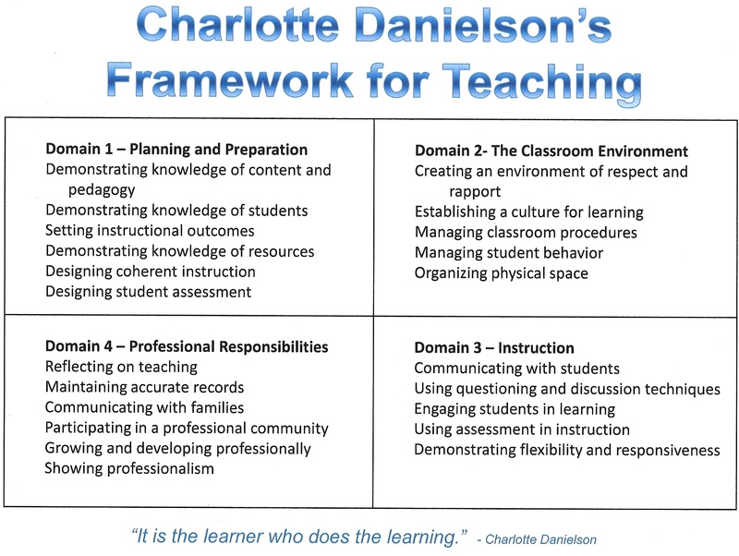

Slide 22
Important Points
Be actively engaged in classroom (no homework, no cell phones)
Maximize your time in the field (be there early and stay as late as possible)
Attend the scheduled days on calendar
Report absences when they occur in Falcon Link
Communicate professionally & build rapport with mentor teacher & supervisor
Write instructional plans for all lessons you teach (minimum of 5 times)
Plan ahead for Video Assignments & upload videos in Yuja ONLY
Spend time each week on intentional goal writing and meaningful reflection
Concurrent courses and assignments
Understand course attributes
Think like an emerging professional – be prepared, flexible, growth mindset

Slide 23
Paperwork and Supervisor Connection
Paperwork
Mandated Reporter Training Certificate
Act 24 Form
Screening Form – TB/Clearances
Messiah University Off-Campus Experience Form
Supervisor Connection

Slide 24
Who to Contact
Questions about this field experience can be directed to the university supervisor and/or the Assistant Director of TEP,
Mrs. Julie McGill
jmcgill@messiah.edu

